Slide 1
Detecting Selection
BIO 594-
University of Rhode Island

Slide 2

Outline
How do we detect selection with population genomic data?
Brief history
Overview of current methods
Live Coding
How do we detect population structure and what does that mean?
Live Coding
Take Home Exercises
BIO 594

Slide 3
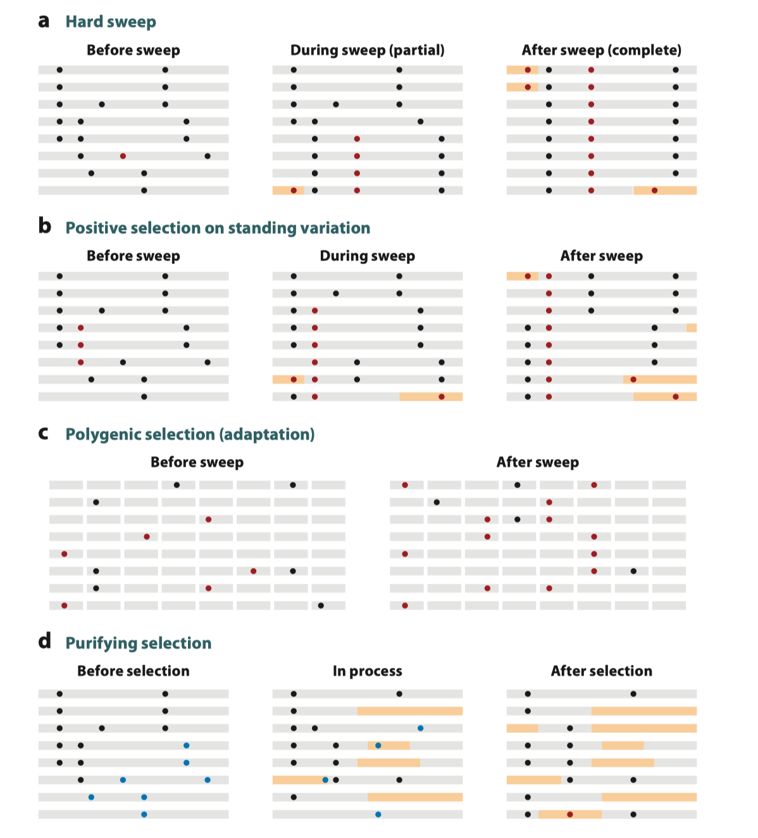
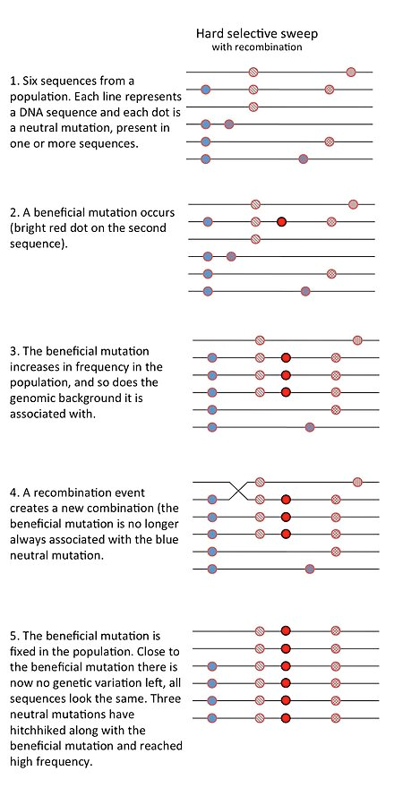
Selection?
BIO 594

Slide 4
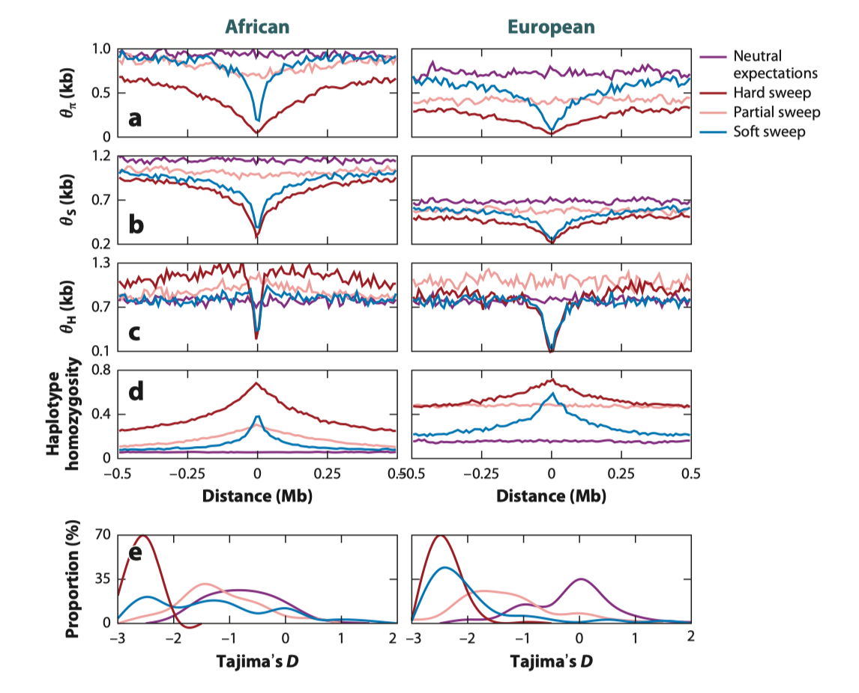
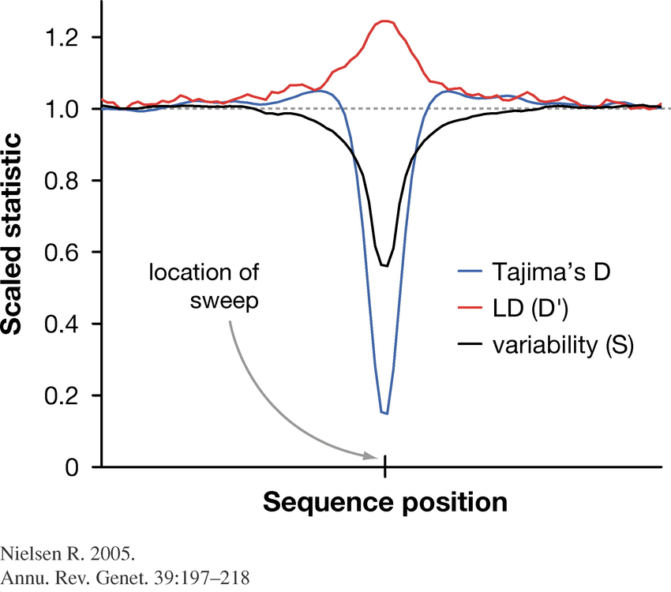
Selection?
BIO 594

Slide 5
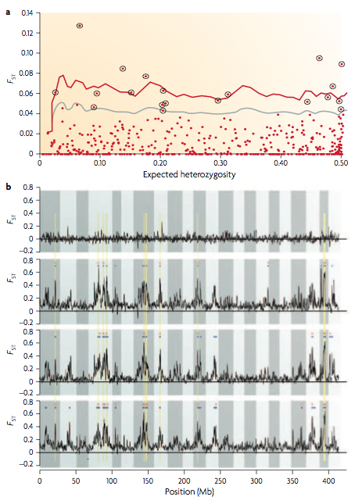
A Little History
Lewontin & Krakaurer (1972)
Posited that forces such as migration and drift should act on all loci equally
Significant heterogeneity in F_{ST} values must be due to selection.
Original test for significance based on Χ² distribution
BIO 594

Slide 6
F_{ST} across all loci

Slide 7
F_{ST} across all loci

Slide 8
F_{ST} across all loci

Slide 9
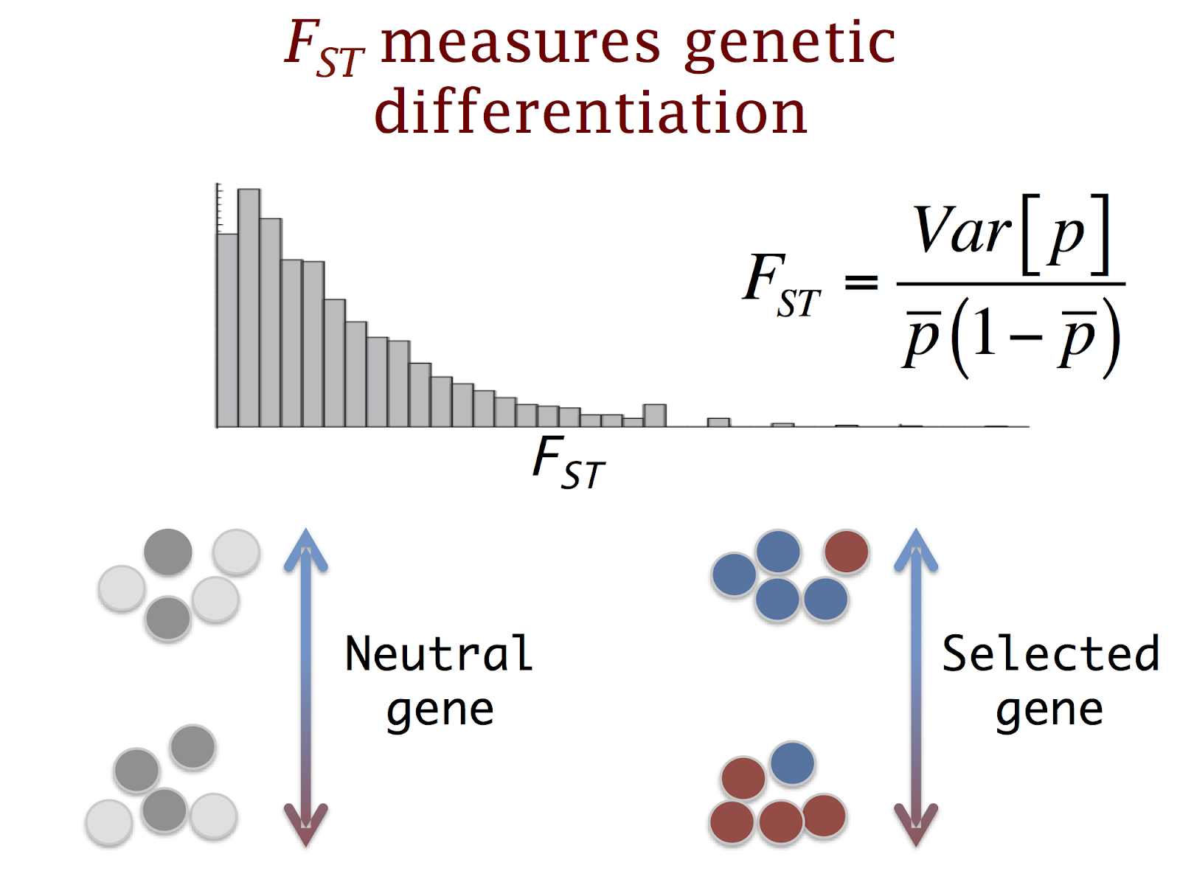
A Little History
Lewontin & Krakaurer (1972)
Posited that forces such as migration and drift should act on all loci equally
Significant heterogeneity in F_{ST} values must be do to selection.
Original test for significance based on Χ² distribution
BIO 594

Slide 10
Current Methods (Not exhaustive)
Association based methods
Logistic regression between binary response variable and environment (Joost et al. 2007)
Generalized Estimating equations (Poncet et al. 2010)
Distance-based Moran Eigen Vector Maps (Brind’Amour et al. 2018)
RDA (Capblancq et al. 2021)
Differentiation based methods
Coalescent based simulations (Beaumont & Nichols 1996; Excofier et al. 2009)
Bayesian estimates of drift and selection (Foll & Gaggioti 2008, extending (Beaumont and Balding (2004)
Unbiased FST distribution tests (Whitlock and Lotterhos 2015)
Bayescan
OutFLANK
Bayesian Estimates of Demography and Environmental Differentiation
An extension of the Lewontin–Krakauer test for structured populations, using a phylogenetic tree to estimate coancestry test statistic (Bonhomm et al 2010; Günther and Coop 2013)
BayEnv2
PCA based methods
Uses PCA analysis and Mahalanobis distance to detect outliers. (Luu et al. 2017)
PCAdapt
BIO 594

Slide 11
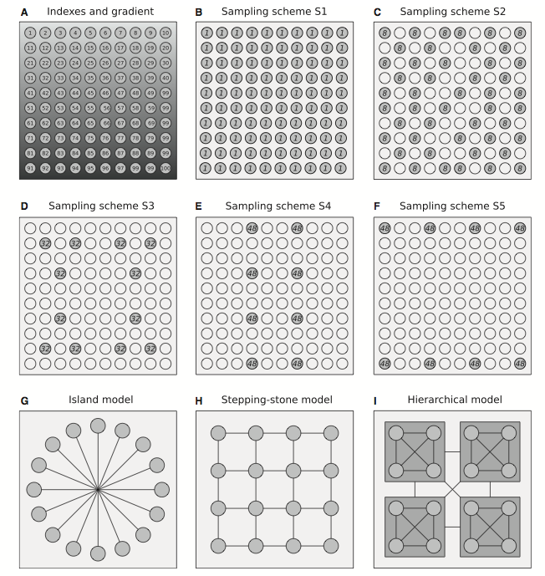
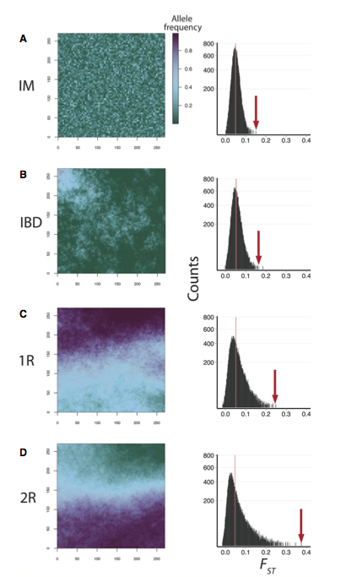
Which one to use??
De Mita et al. 2013
Lotterhos & Whitlock 2014
BIO 594

Slide 12
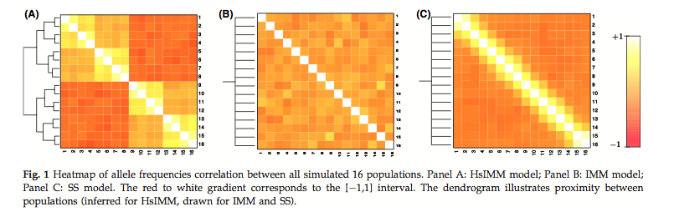
Which one to use??
If selection is polygenic, power decreases substantially across all methods (Villemereuil et al. 2013).
However, using multiple methods helps to reduce error rates.
BIO 594

Slide 13
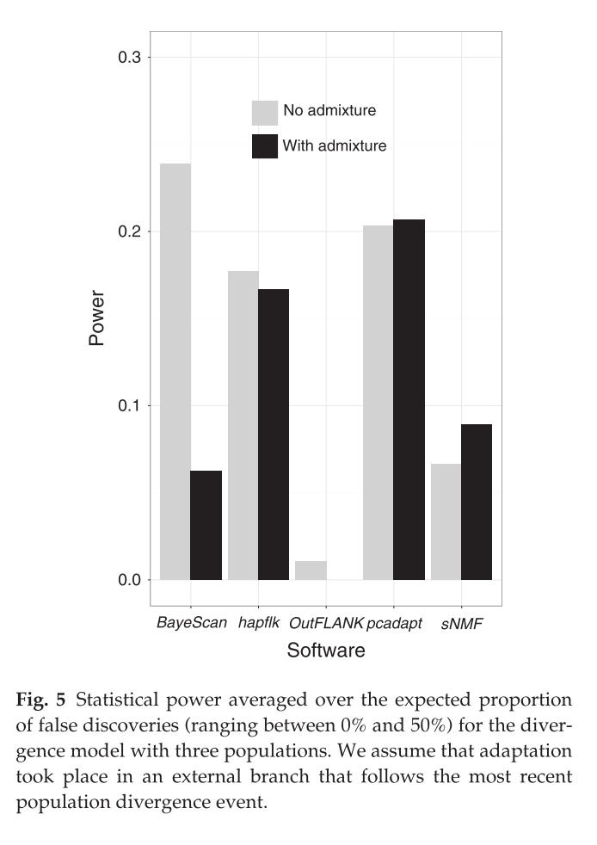
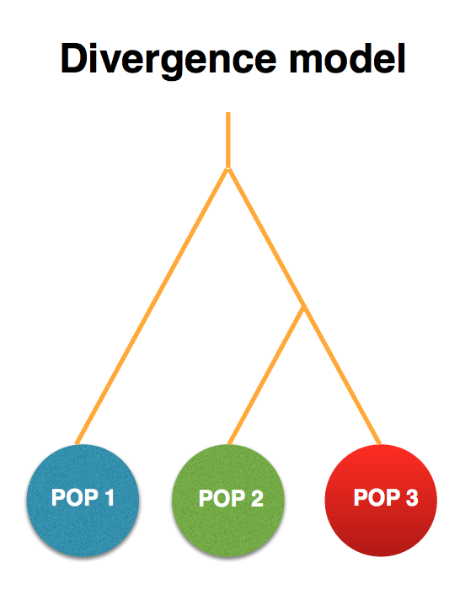
Which one to use???
Luu et al. 2017
BIO 594

Slide 14
Discussion
Lotterhos and Witlock 2015
Lotterhos 2019
Booker et al. 2020
Capblancq 2021
BIO 594

Slide 15
Which one to use????
Program | What kind of sampling | What it measures
OutFLANK | Individuals grouped into populations | Outliers for genetic differentiation
SelEstim | Individuals grouped into populations (?) | Outliers for genetic differentiation
PCAdapt | Individuals (don’t have to be in populations) | Outliers for genetic differentiation
FLK/hapFLK | Individuals grouped into populations | Outliers for genetic differentiation
REHH | Individuals from one population or pair | Linkage disequilibrium around a locus
SWEED | Individuals from one population | Genetic variation around a locus - allele frequency spectrum
BayPass | Individuals grouped into populations, may associate with environmental variables | Outliers for genetic differentiation (XtX) and associations between allele frequencies and environments
LEA | Individuals (don’t have to be grouped into populations) and environmental variables | Associations between allele frequencies and environments
Table Courtesy of Katie Lotterhos
BIO 594

Slide 16
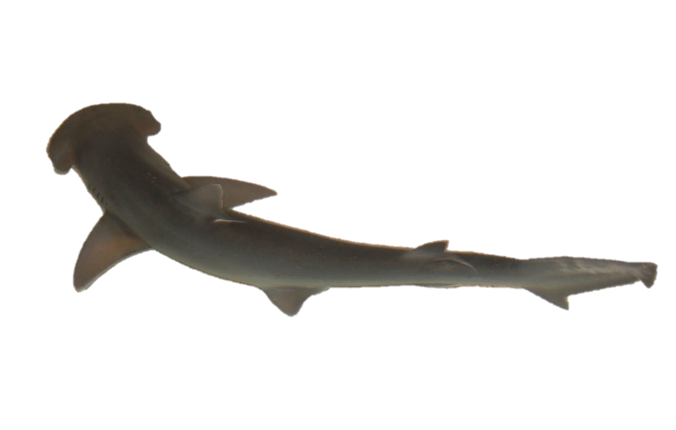
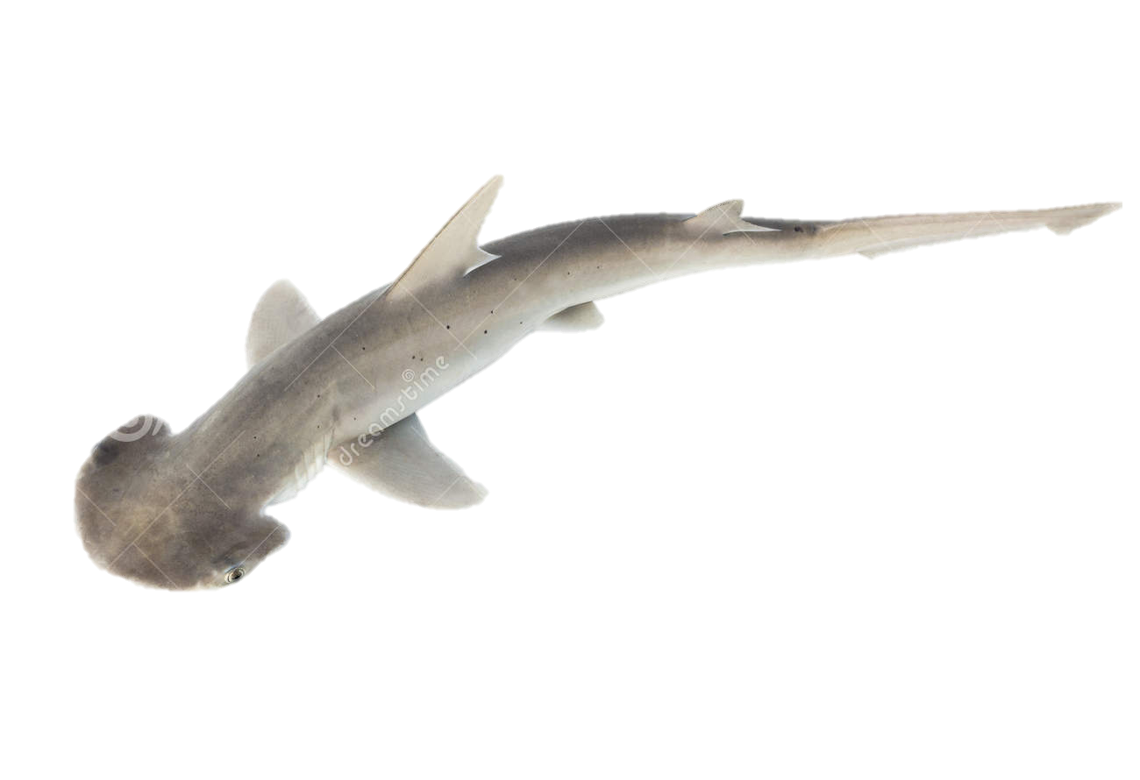
Bonnethead Sharks (Sphyrna tiburo)
Found in coastal waters of western Atlantic and Gulf of Mexico
Known to use nearshore habitat for gestation and parturition
Thought to exhibit female philopatry
extensive maternal investment
natal habitats differ substantially
Significant differences in life history among across geographic regions
Size at age
Growth rate
Size and age at maturity

Slide 17
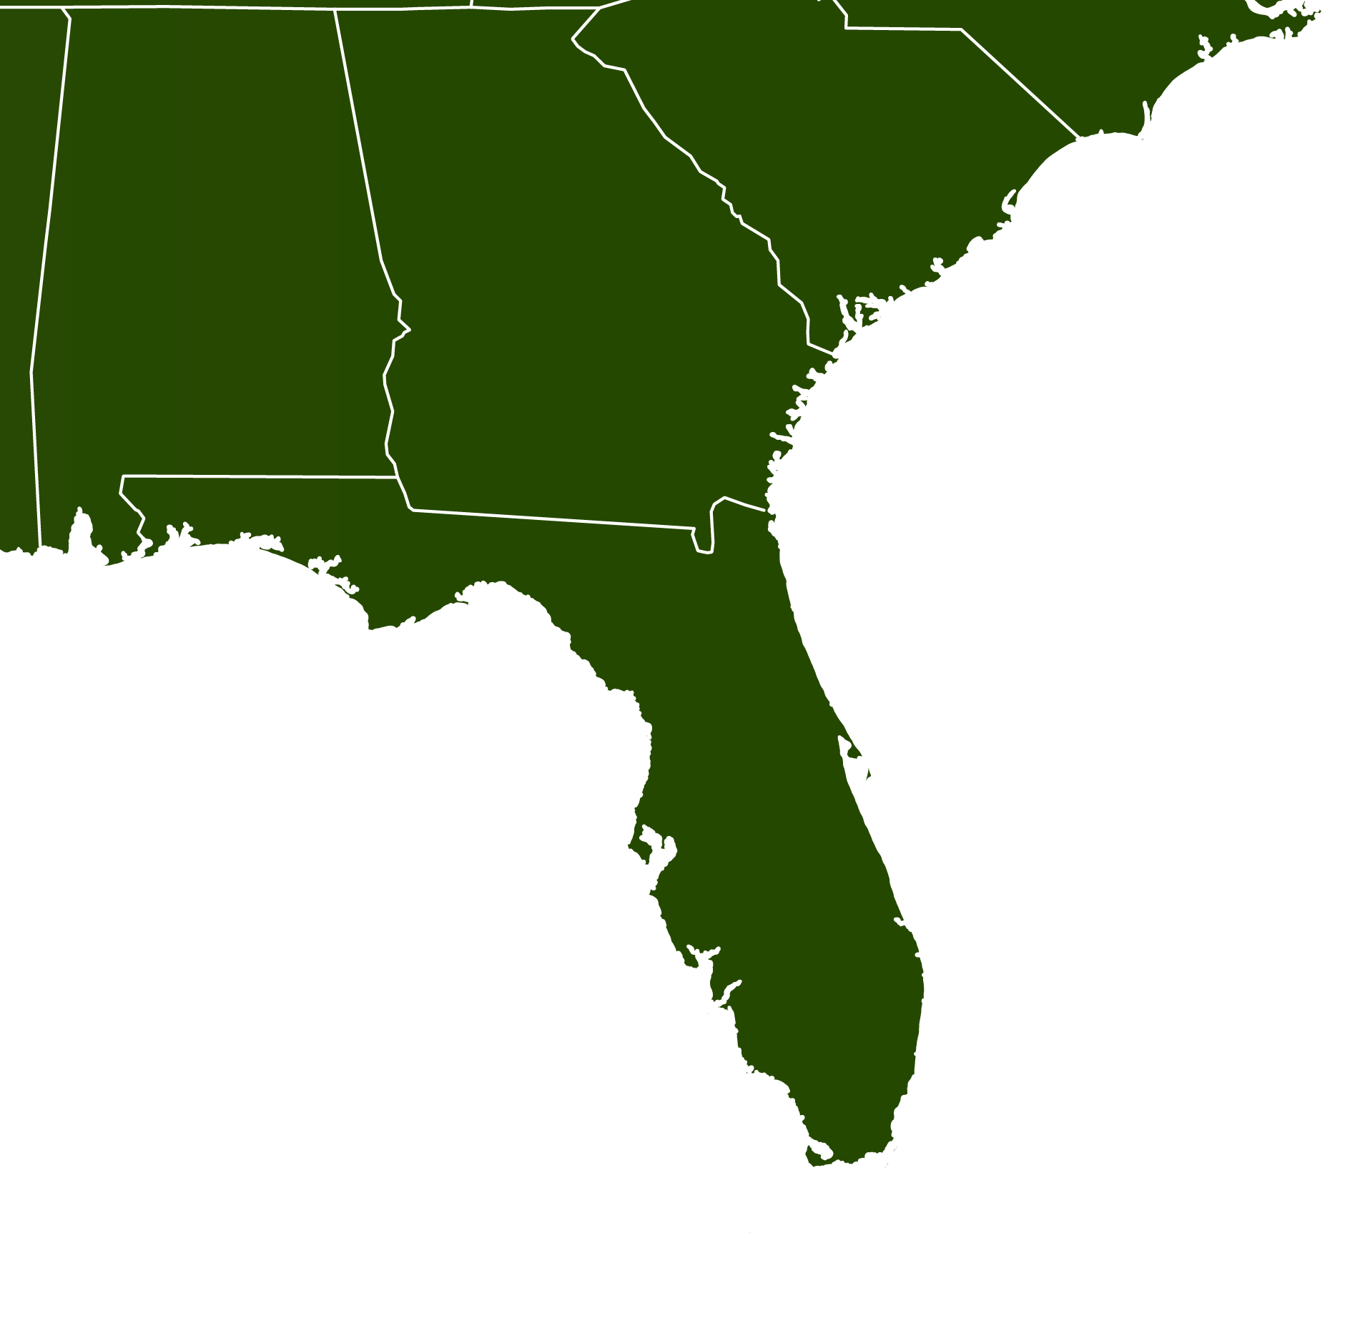
Bonnethead Population Genomics
Surveyed 134 individuals from 4 different localities
ddRAD sequencing
Sanger sequencing
NC
22
PC
36
TB
31
FB
31

Slide 18
Bonnethead DAPC
Neutral
NC
22
PC
36
Outlier
TB
31
FB
31

Slide 19
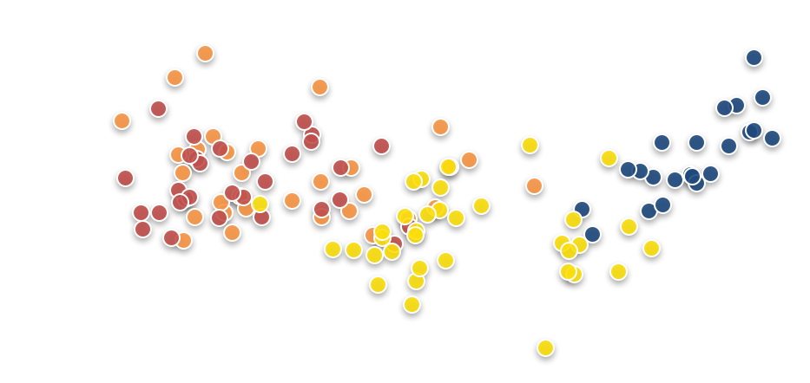
Drivers of outlier allele frequencies
NC
22
PC
36
TB
31
FB
31

Slide 20
Drivers of outlier allele frequencies
NC
22
PC
36
TB
31
FB
31
18 O-SNP loci had r² values ≥ 0.90
Explained 75.6% of X axis variation

Slide 21
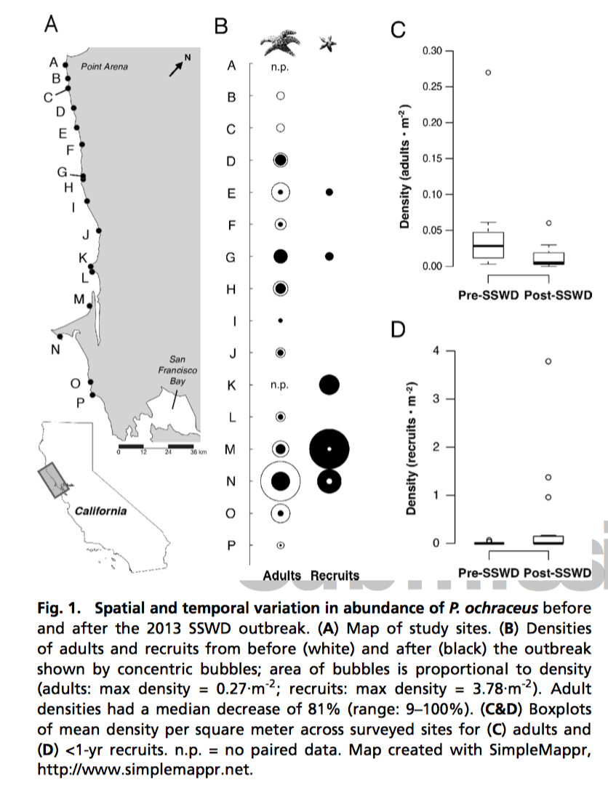
DAPC for detecting selection
Schiebelhut et al. 2018

Slide 22
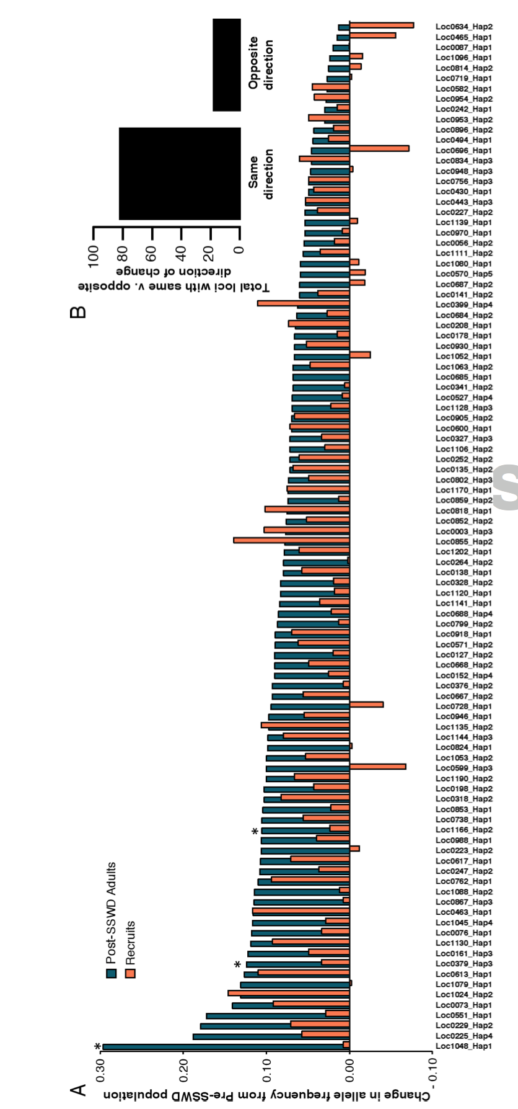
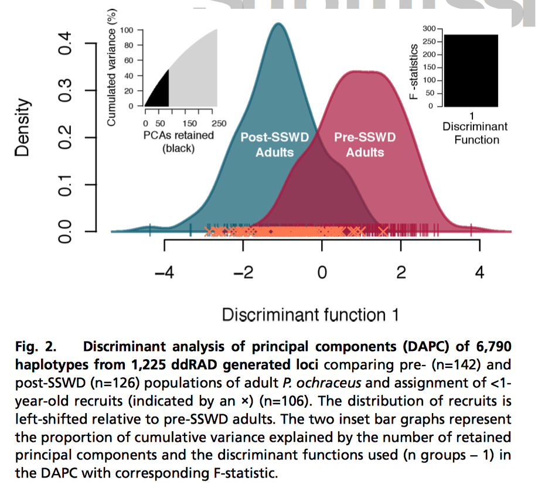
DAPC for detecting selection
Schiebelhut et al. 2018

Slide 23
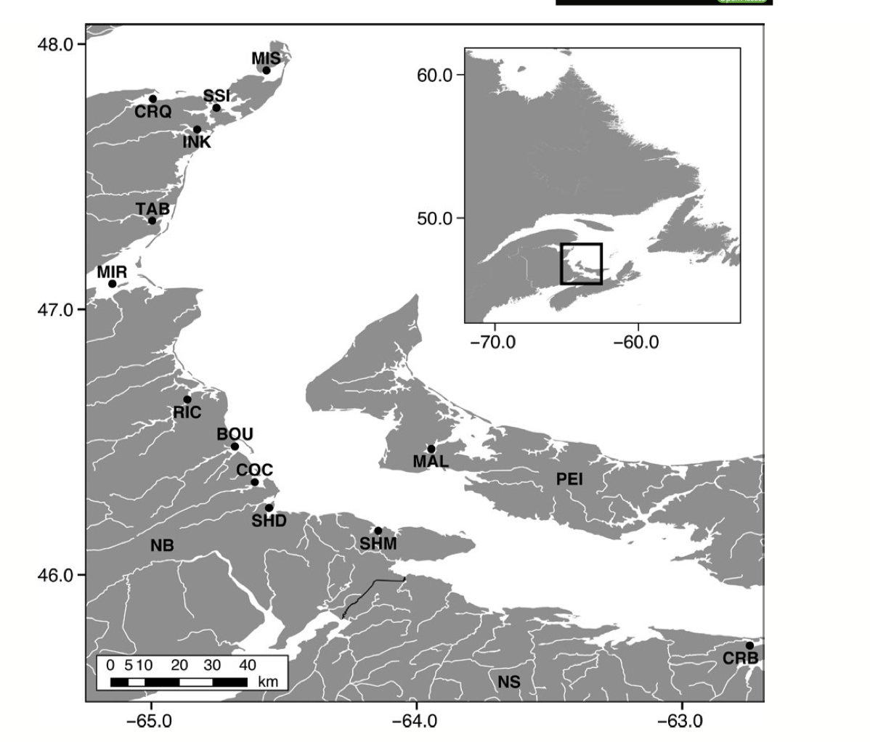
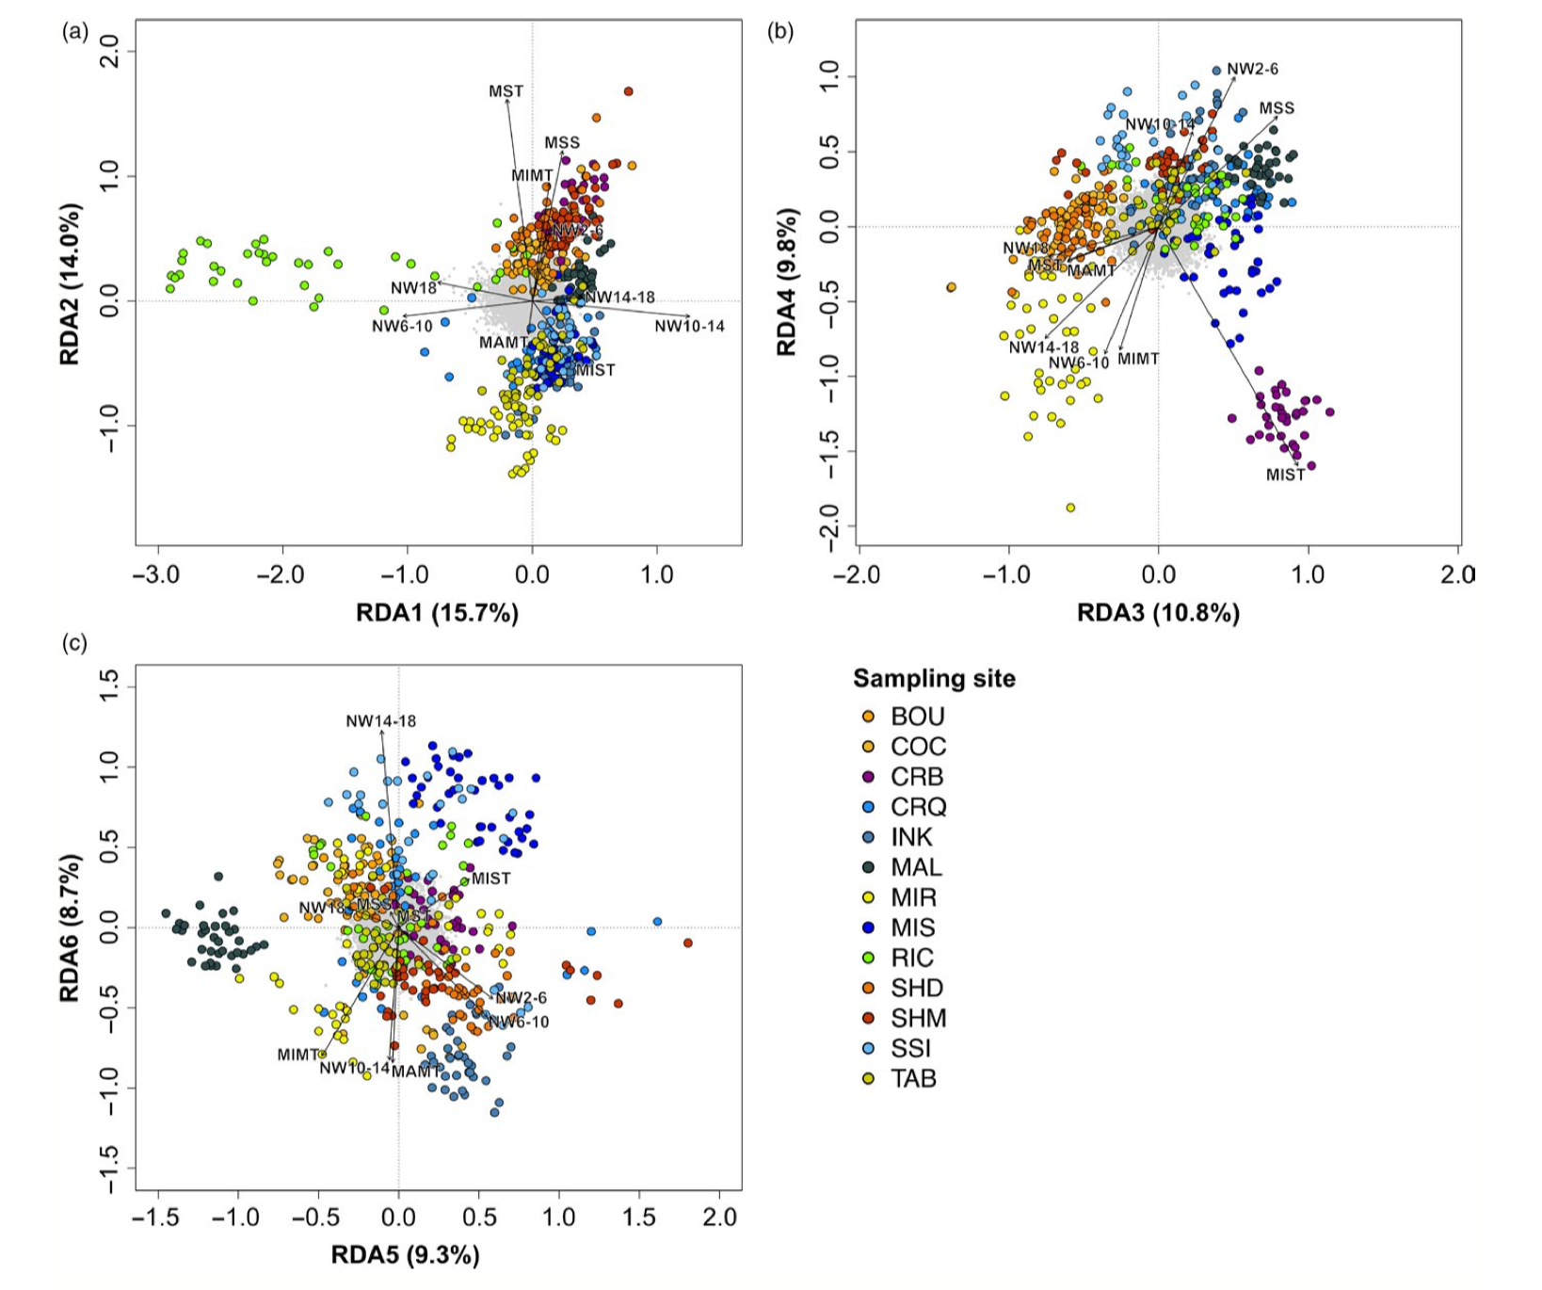
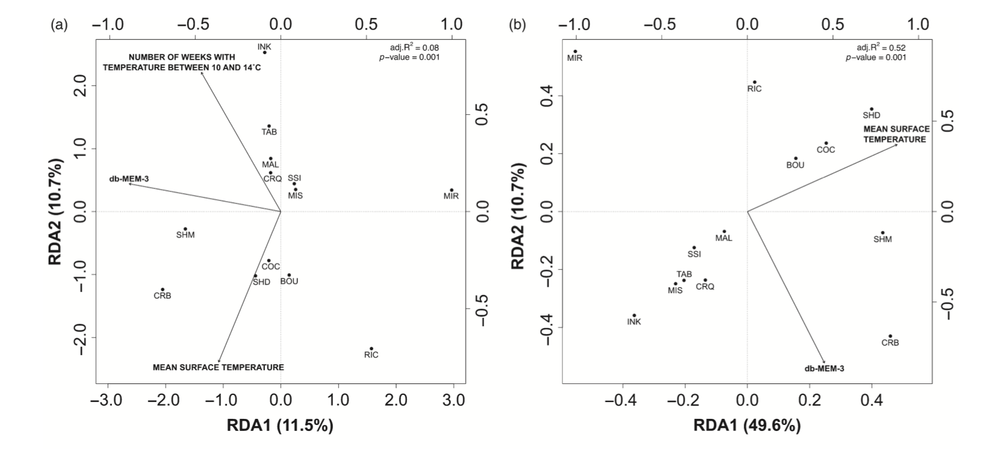
dbMEM paired with RDA
Bernetchez et al. 2019

Slide 24
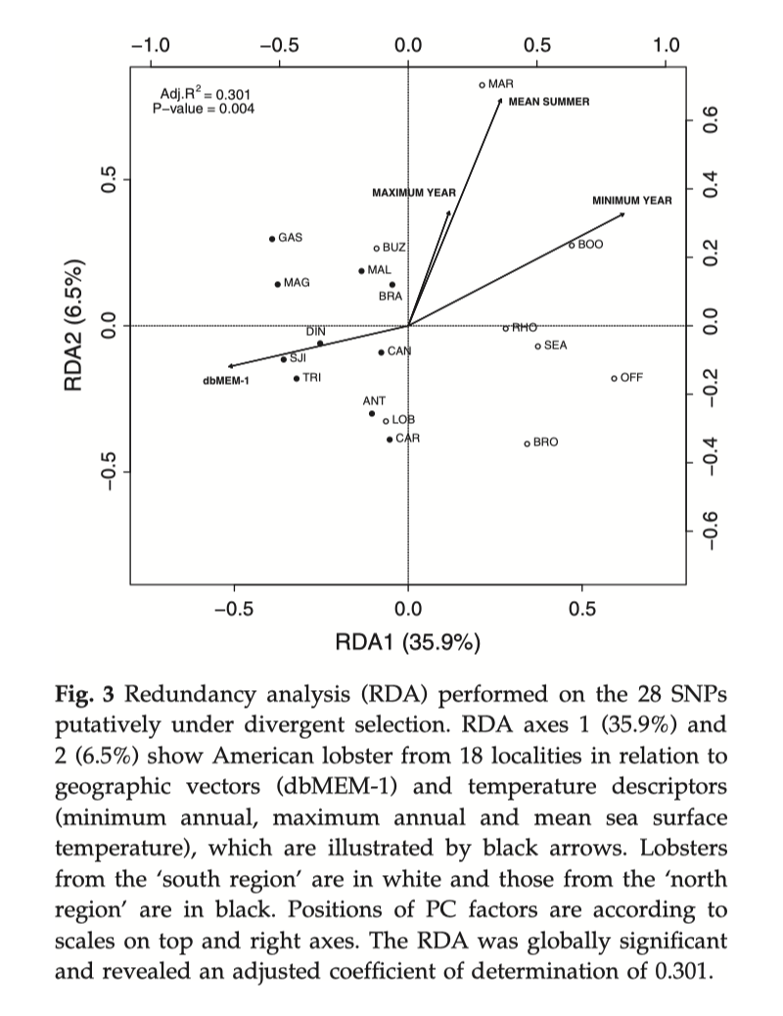
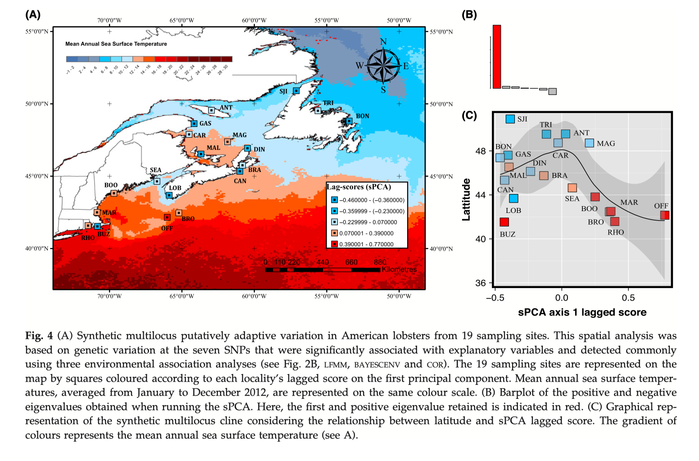
dbMEM paired with RDA
Benestan et al. 2017

Slide 25
Live Coding

Slide 26
Population Structure
BIO 594-
University of Rhode Island

Slide 27
Traditional population genetics
Population genetics is based on sampling discrete interbreeding subpopulations.
Wright/Fisher Island Model
all sub populations are in HWE
1 = p² + 2pq + q²
Migration is equal across subpopulations
BIO 594

Slide 28
Traditional population genetics
Questions?
Population connectivity
Long term
Demographic
Effective population size
Bottlenecks?
What is a population?
Admixture?
When did populations diverge?
BIO 594

Slide 29
Traditional population genetics
Population genetics is based on sampling discrete interbreeding subpopulations.
Stepping-stone model
All subpopulations are in HWE
Migration is equal only between
neighboring populations
Island/Continent model
Metapopulation model
BIO 594

Slide 30
Understanding F_{ST}
BIO 594

Slide 31
Understanding F_{ST}
No Connectivity
F_{ST} = 1.0
BIO 594

Slide 32
Understanding F_{ST}
Low Connectivity
F_{ST} = 0.36
BIO 594

Slide 33
Understanding F_{ST}
High Connectivity
F_{ST} = 0.0
BIO 594

Slide 34
Spatial patterns in population genetics
Isolation by distance
Genetic distance increases with geographic distance
For a long time, this was one of the only spatially explicit models in population genetics
Usually performed on transformed genetic and Euclidean/Cartesian distances
Using a mantel test
Testing the correlation between two matrices
BIO 594

Slide 35
Fine-scale genetic structure of Red Snapper in the northern Gulf of Mexico
Jonathan B. Puritz, David S. Portnoy, and John R. Gold

Slide 36
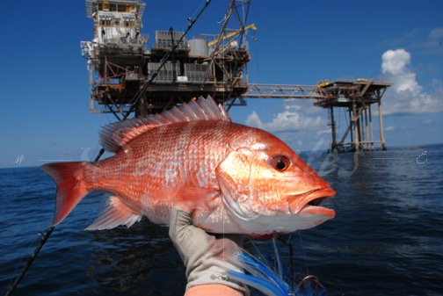
Red Snapper as a fishery
Red Snapper is one of the largest and most valuable US Fisheries
~10 million lbs per year
>$720 million per year

Slide 37
Population structure and management
Different subpopulations may possess adaptations that promote differences in critical life history parameters
growth
fecundity
disease resistance
Different subpopulations may also have different effective population sizes and migration rates
correlates to vulnerability from exploitation

Slide 38
Red Snapper population structure?
Neutral genetic markers have been largely unable to detect local or regional spatial structure
Though structure was detected between GOM and Atlantic (Hollenbeck et al. 2015)
Among young of the year (YOY), genotypes are spatially autocorrelated within 50-100 km (Saillant et al. 2010)

Slide 39
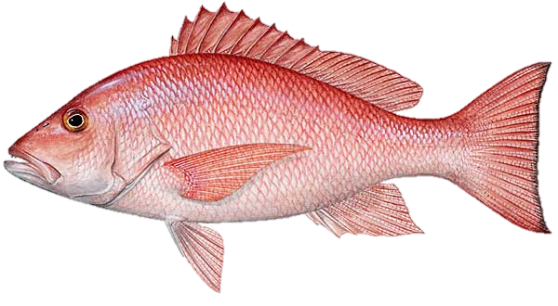
RAD data
Quality Filtering
De Novo Assembly
Read Mapping
SNP Calling
SNP Filtering
SNPs were filtered by genotype depth, allelic balance, HWE, average locus depth, and a variety of other bioinformatics
4,337 SNPs haplotyped into 2,073 RAD loci
205 individuals from 8 localities

Slide 40
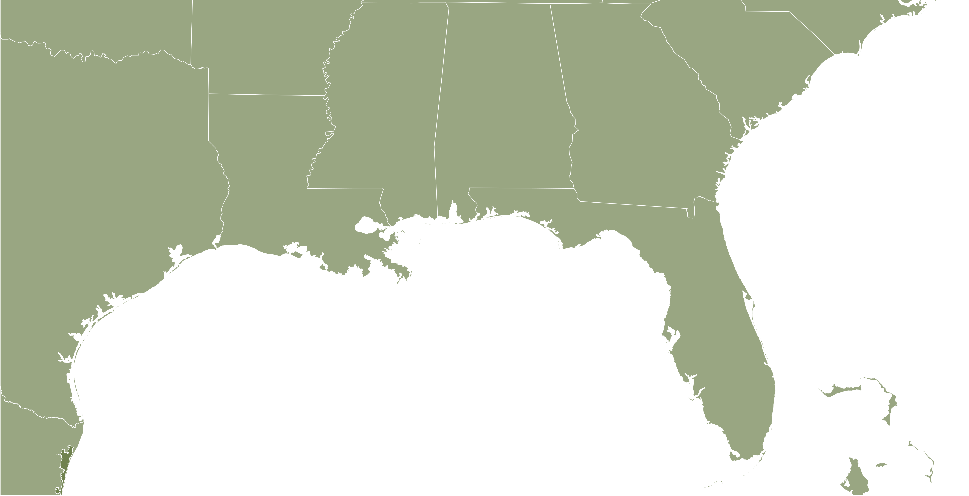
Changing the scale

Slide 41
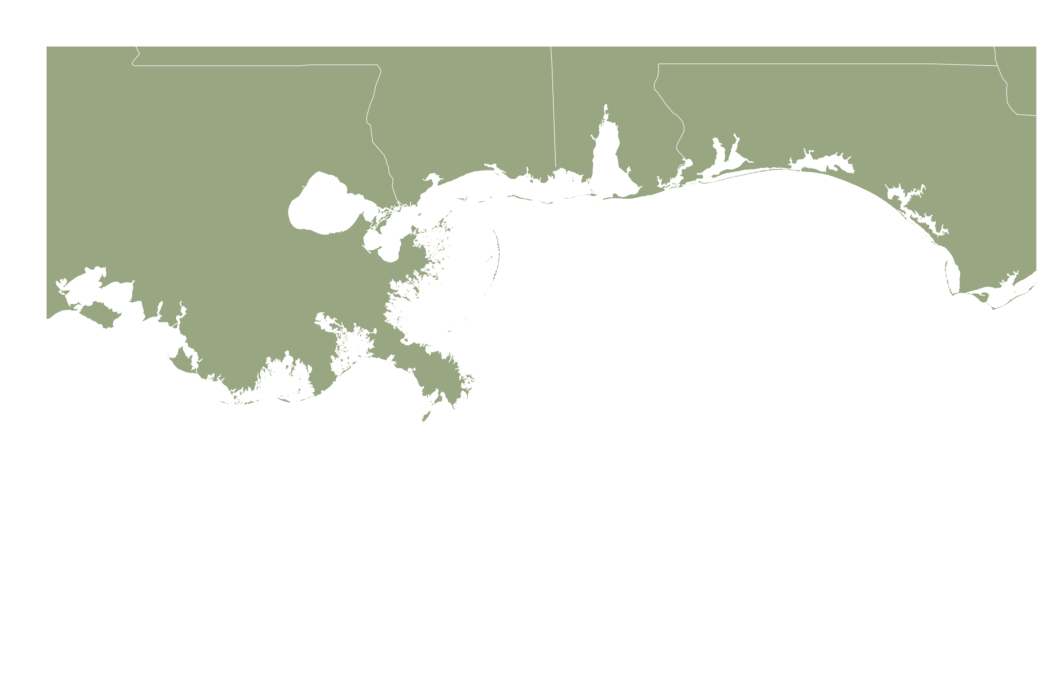
Fine-scale sampling

Slide 42
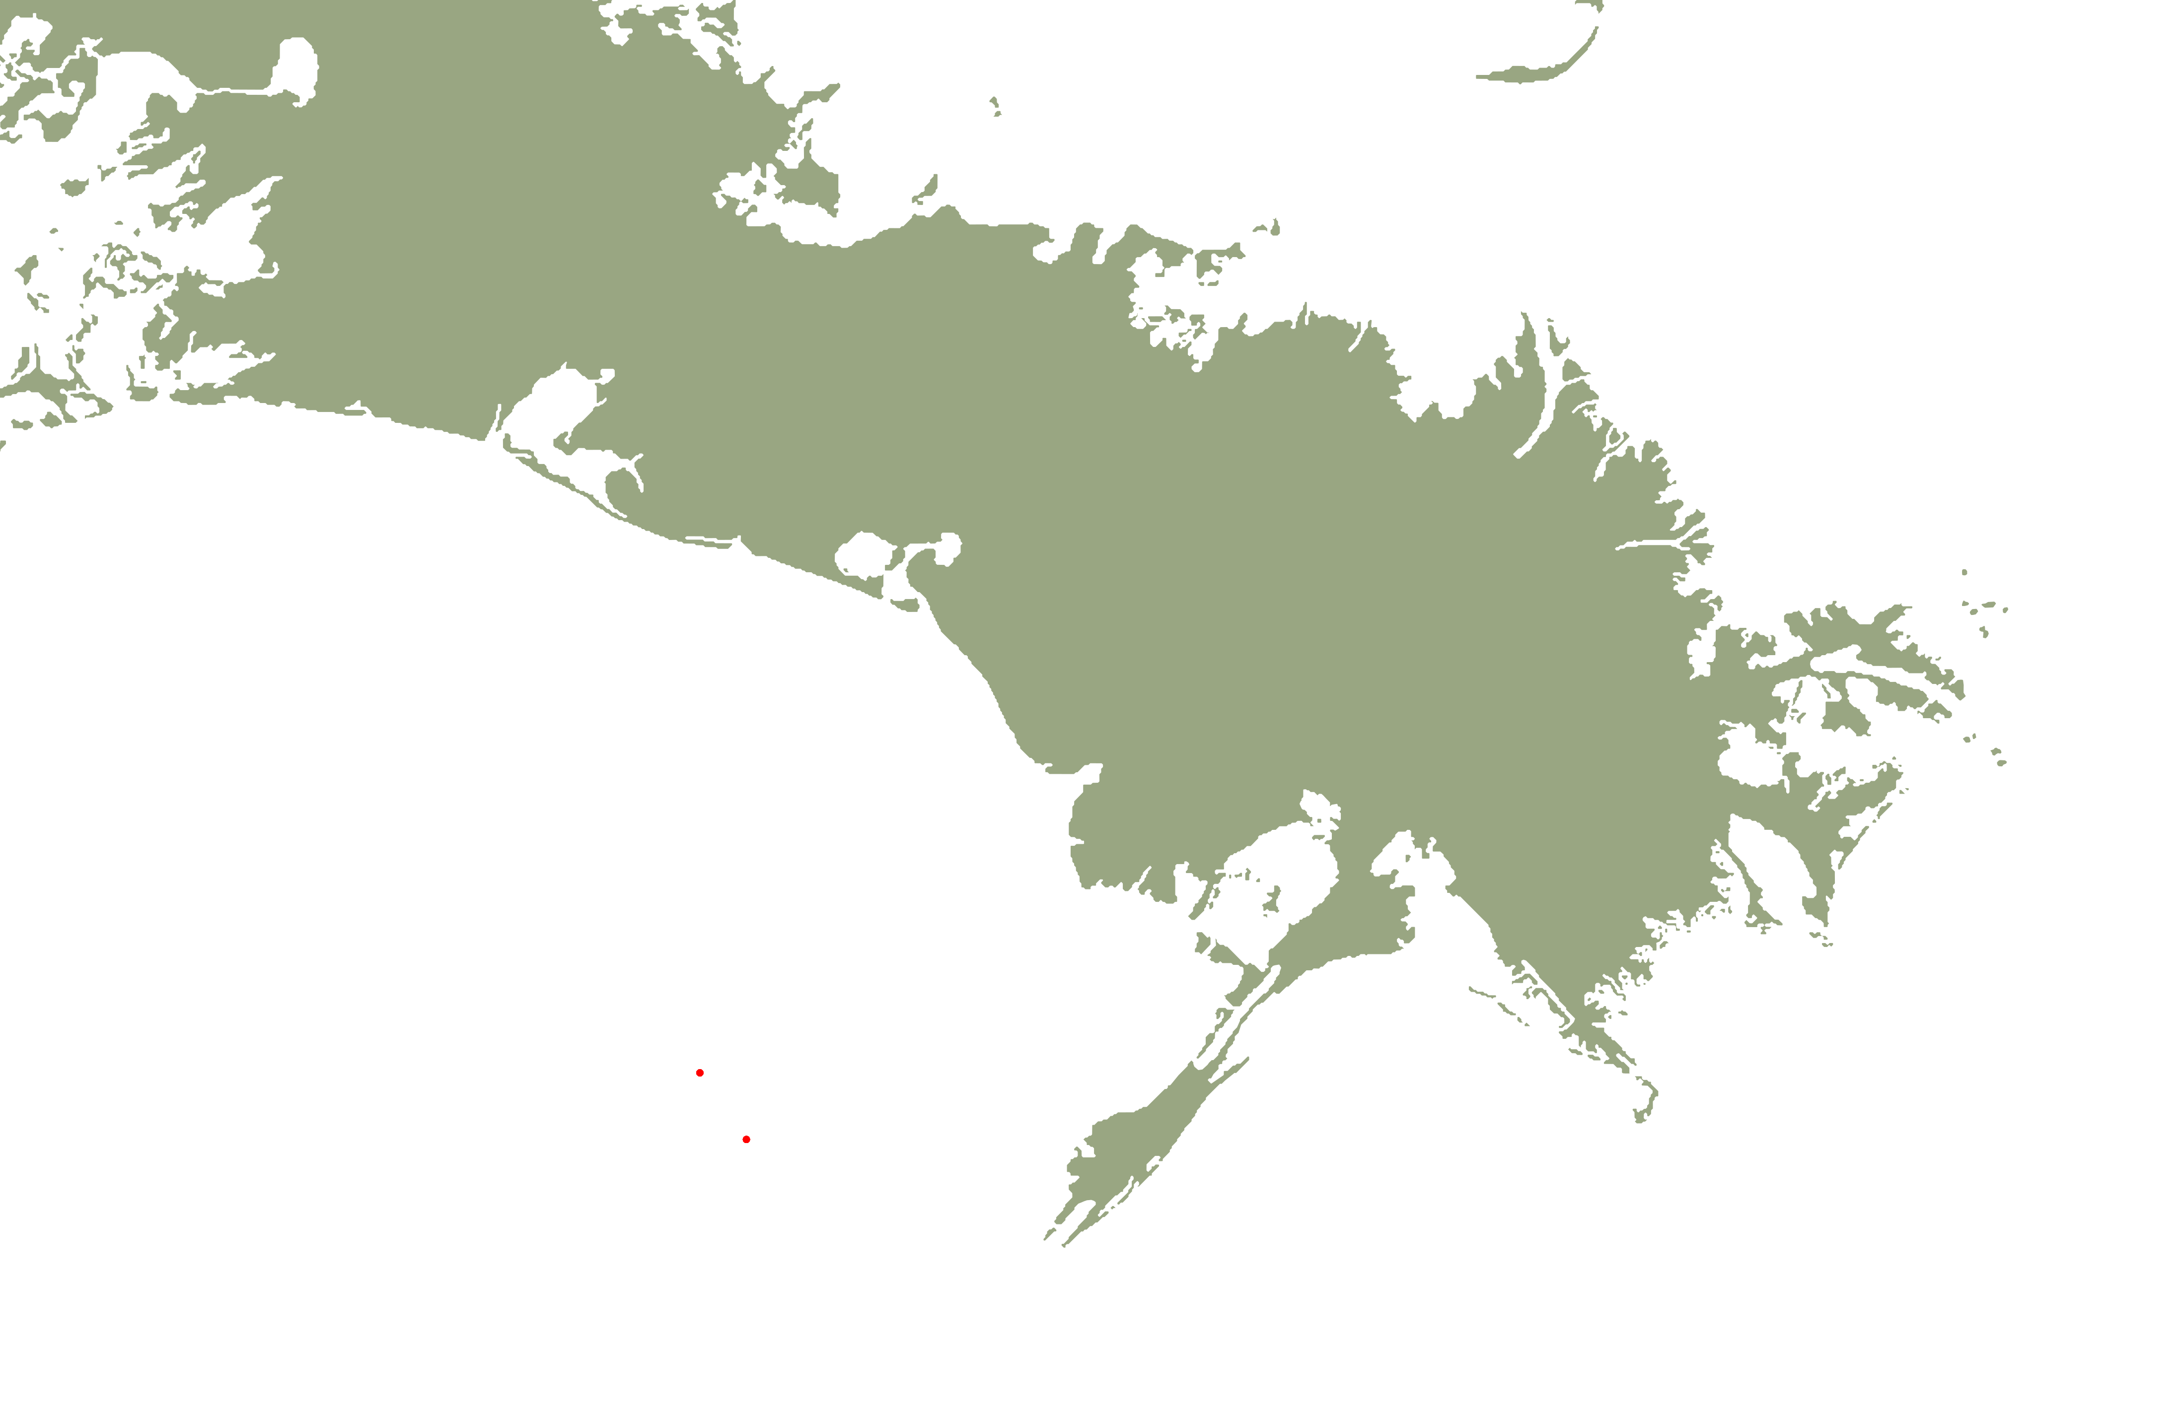
Fine-scale sampling
5
10 km
0

Slide 43
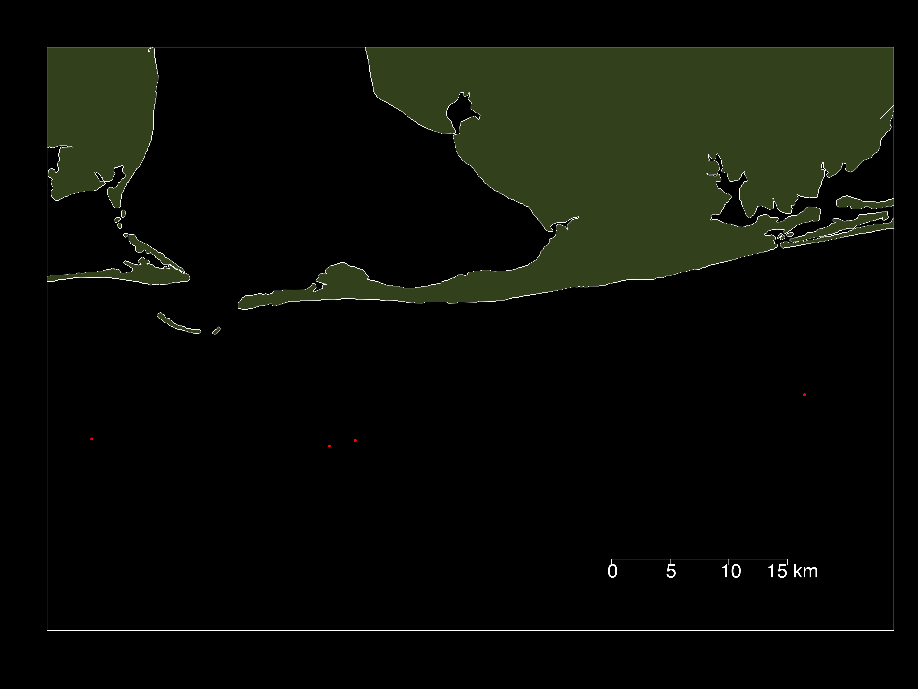
Fine-scale sampling
5
10
0
15 km

Slide 44
Fine-scale structure
NR1
NR2
AR1
AR2
AP2
NR3
NR4
AP1

Slide 45
Fine-scale structure
NR1
NR2
AR1
AR2
AP2
NR3
NR4
 | AP1 | NR3 | NR4 | NR1 | AR1 | AR2 | NR2
NR3 | 0.0008
NR4 | 0.0013 | -0.0006
NR1 | 0.0009 | 0.0004 | 0.0009
AR1 | 0.0021 | 0.0004 | 0.0015 | 0.0018
AR2 | 0.0005 | 0.0008 | -0.0002 | 0.0004 | 0.0022
NR2 | 0.0021 | 0.0005 | 0.0009 | 0.0025 | 0.0023 | 0.0015
AP2 | 0.0017 | 0.0006 | 0.0022 | 0.0009 | 0.0013 | 0.0009 | 0.0036
AP1

Slide 46
Fine-scale structure
NR1
NR2
AR1
AR2
AP2
NR3
NR4
 | AP1 | NR3 | NR4 | NR1 | AR1 | AR2 | NR2
NR3 | 0.0008
NR4 | 0.0013 | -0.0006
NR1 | 0.0009 | 0.0004 | 0.0009
AR1 | 0.0021 | 0.0004 | 0.0015 | 0.0018
AR2 | 0.0005 | 0.0008 | -0.0002 | 0.0004 | 0.0022
NR2 | 0.0021 | 0.0005 | 0.0009 | 0.0025 | 0.0023 | 0.0015
AP2 | 0.0017 | 0.0006 | 0.0022 | 0.0009 | 0.0013 | 0.0009 | 0.0036
AP1

Slide 47
Fine-scale structure
NR1
NR2
AR1
AR2
AP2
NR3
NR4
 | AP1 | NR3 | NR4 | NR1 | AR1 | AR2 | NR2
NR3 | 0.0008
NR4 | 0.0013 | -0.0006
NR1 | 0.0009 | 0.0004 | 0.0009
AR1 | 0.0021 | 0.0004 | 0.0015 | 0.0018
AR2 | 0.0005 | 0.0008 | -0.0002 | 0.0004 | 0.0022
NR2 | 0.0021 | 0.0005 | 0.0009 | 0.0025 | 0.0023 | 0.0015
AP2 | 0.0017 | 0.0006 | 0.0022 | 0.0009 | 0.0013 | 0.0009 | 0.0036
AP1

Slide 48
Drivers of fine-scale structure?
Selection
Pre- or post-settlement

Slide 49
Is selection driving the pattern?
NR1
NR2
AR1
AR2
AP2
NR3
NR4
AP1

Slide 50
Drivers of fine-scale structure?
Selection
Pre or post settlement
Differential reproductive success
“Sweepstakes recruitment”

Slide 51
Sweepstakes?
NR1
NR2
AR1
AR2
AP2
NR3
NR4
F = 11.5114, p < 0.001
AP1

Slide 52
Drivers of fine-scale structure?
Selection
Pre or post settlement
Differential reproductive success
“Sweepstakes recruitment”
Population Subdivision

Slide 53
Subdivision?
NR1
NR2
AR1
AR2
AP2
 | Estimate | 95% CI
AP1 | Infinity | 15,717- Infinity
NR3 | 5,021 | 2,389 - Infinity
NR4 | Infinity | Infinity-Infinity
NR1 | 10,540 | 5,025 - Infinity
AR1 | 1,281 | 1,022 - 1,714
AR2 | 59,110 | 8,819 - Infinity
NR2 | 1,663 | 1,254 - 2,466
AP2 | 3,835 | 2,238 - 13,308
NR3
NR4
AP1

Slide 54
Subdivision?
NR1
NR2
AR1
AR2
AP2
 | Estimate | 95% CI
AP1 | Infinity | 15,717- Infinity
NR3 | 5,021 | 2,389 - Infinity
NR4 | Infinity | Infinity-Infinity
NR1 | 10,540 | 5,025 - Infinity
AR1 | 1,281 | 1,022 - 1,714
AR2 | 59,110 | 8,819 - Infinity
NR2 | 1,663 | 1,254 - 2,466
AP2 | 3,835 | 2,238 - 13,308
NR3
NR4
AP1

Slide 55
Implications
Likely multiple brooding stocks
Could be inherent meta-population structure
spatial or temporal demes
Juvenescence of the fishery could be creating structure
Younger fish produce less and lower quality eggs, sperm, and larvae
Reduce pools of potential parents
Limit larval connectivity between localities
Only one year of data
Could just be an outlier
However, estimates of recruitment for the last decade peaked during 2012 (SEDAR 2013)

Slide 56
From old school to new school

Slide 57
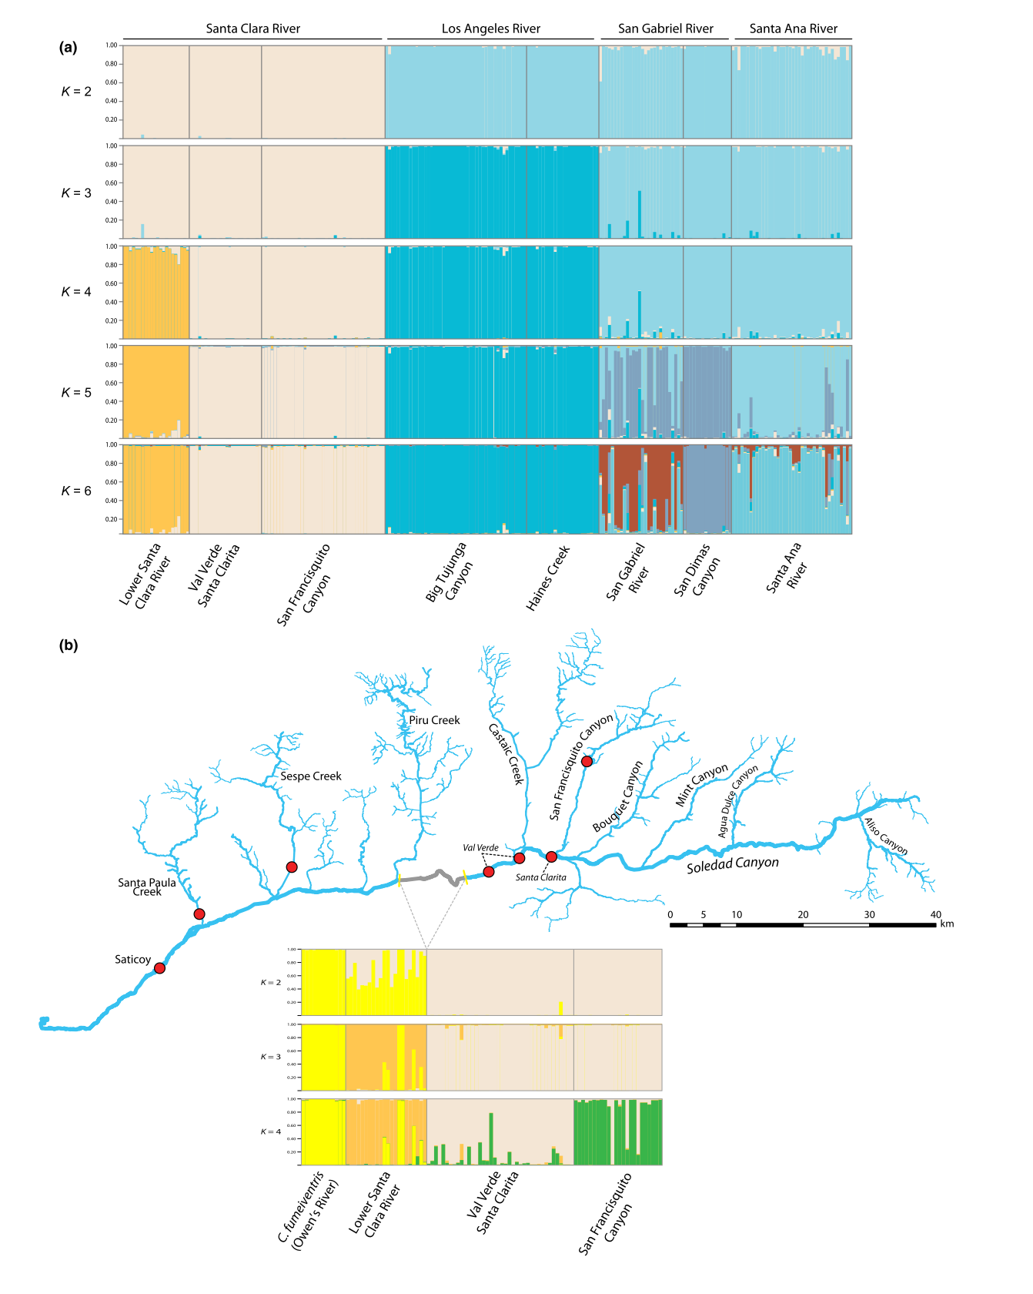
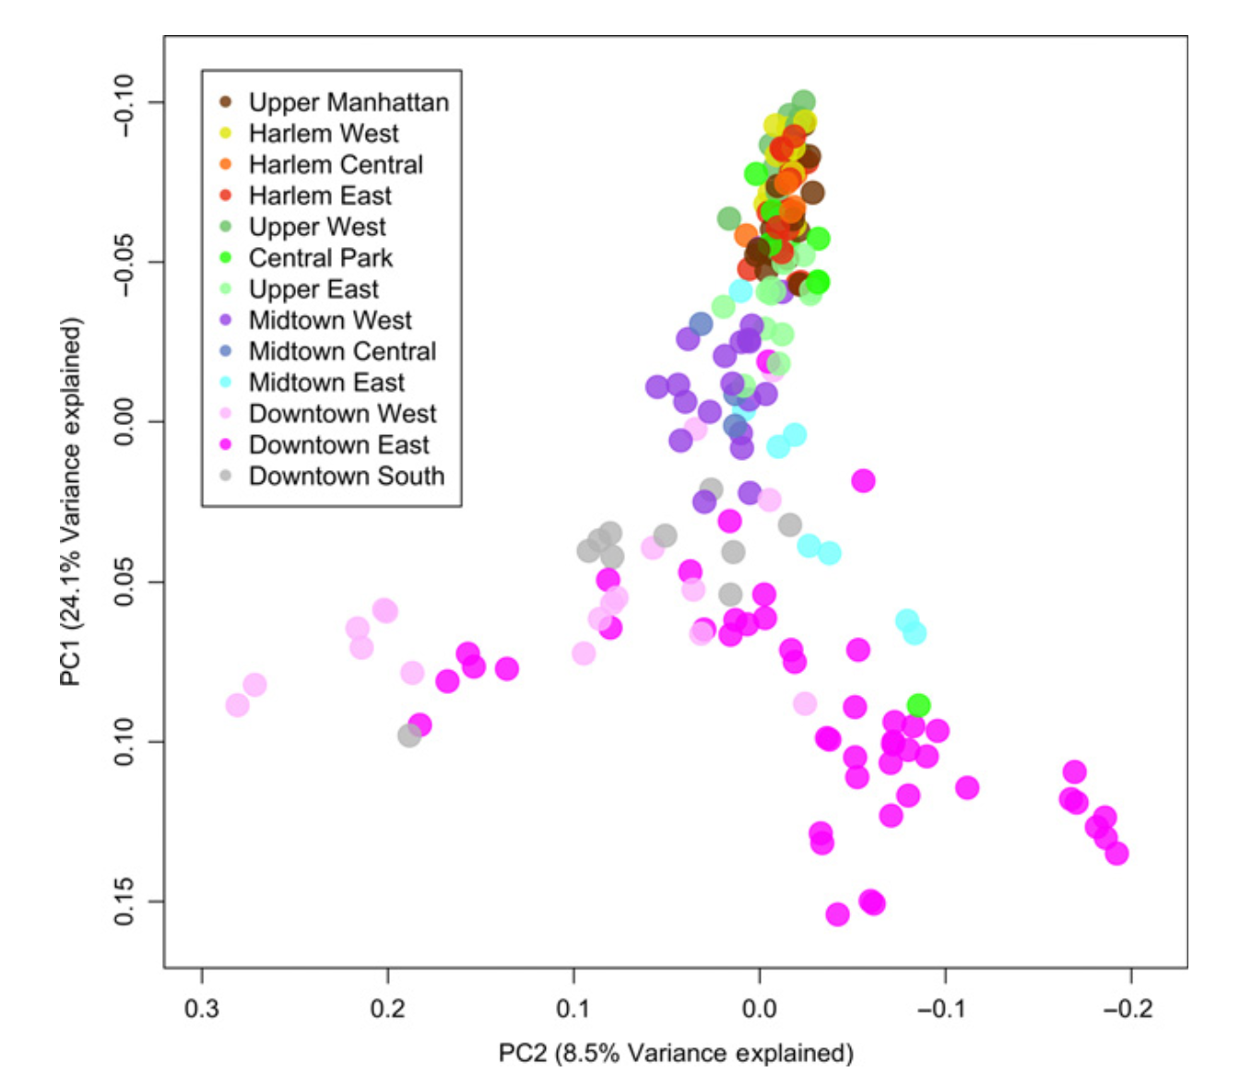
What is a population?
Technological improvements began shifting the focus of sampling from populations towards individuals
Bayesian clustering methods
Principal components analysis (PCA)
BIO 594

Slide 58
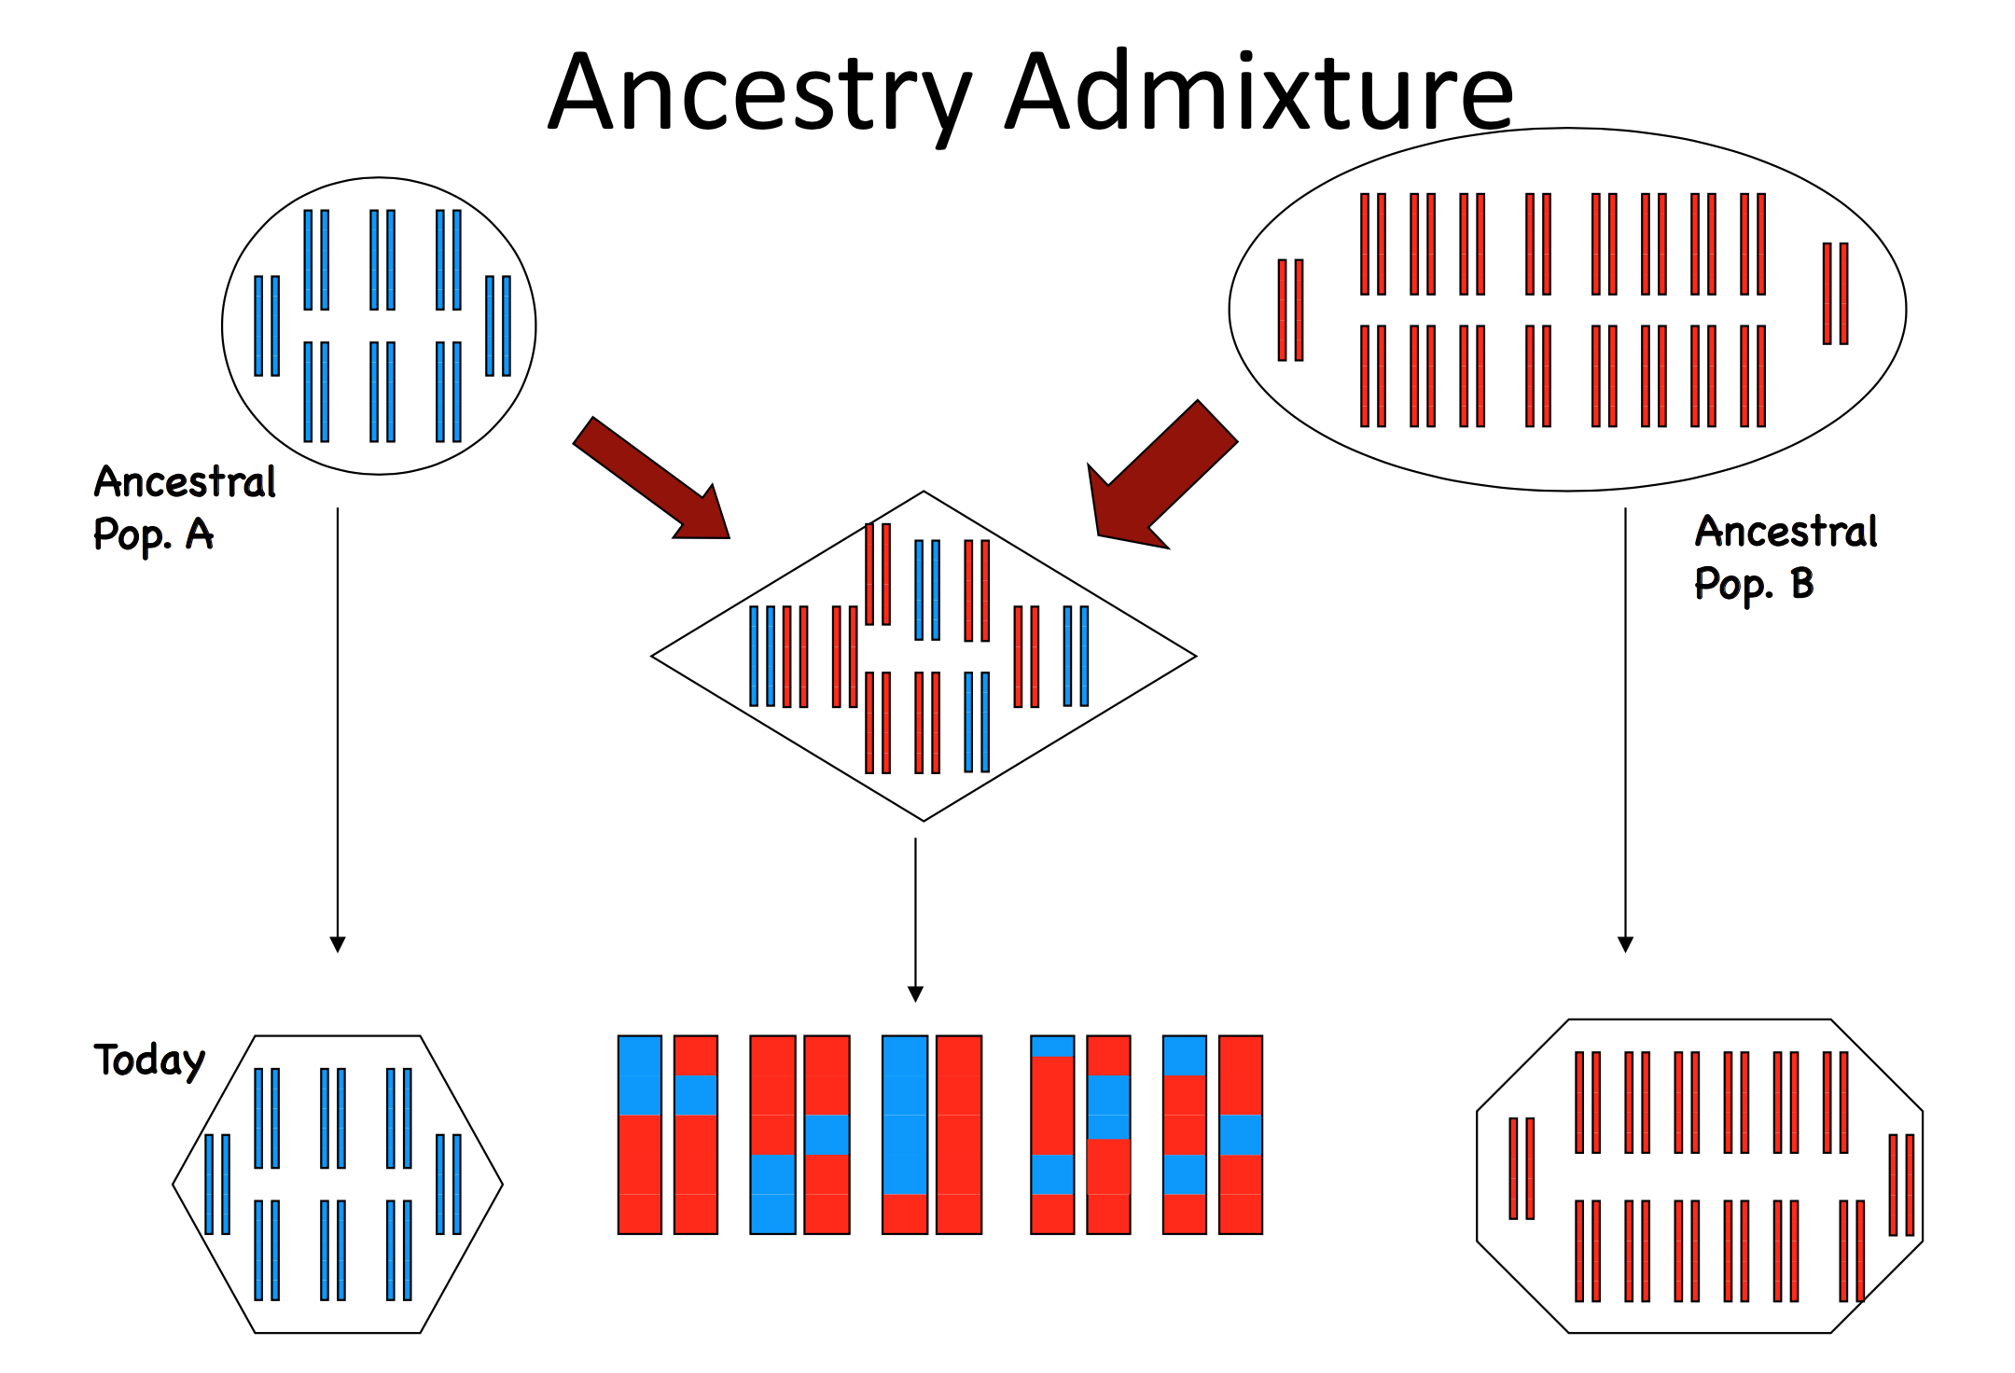
What is a population?
Structure model
Assumes that individual genomes are comprised of a combination of multiple ancestral alleles
Clusters can be identified by grouping individuals by maximizing HWE and minimizing LD
BIO 594

Slide 59
What is a population?
Structure model
Assumes that individual genomes are comprised of a combination of multiple ancestral alleles
Clusters can be identified by grouping individuals by maximizing HWE and minimizing LD
BIO 594

Slide 60
What is a population?
Structure model
Assumes that individual genomes are comprised of a combination of multiple ancestral alleles
Clusters can be identified by grouping individuals by maximizing HWE and minimizing LD
BIO 594

Slide 61
What is a population?
PCA
Imagine creating a giant matrix of genotypes arranged in rows of individuals and columns of loci
PCA reduces the dimensionality of all genetic variation by eigendecomposition
Axes of variation are defined by linear combinations of loci
 | Locus 1 | Locus 2 | Locus 3 | Locus 4
Individual 1 | 0 | 1 | 2 | 0
Individual 2 | 1 | 1 | 2 | 1
Individual 3 | 0 | 0 | 0 | 1
Individual 4 | 2 | 2 | 1 | 0
BIO 594

Slide 62
What is a population?
PCA
Imagine creating a giant matrix of genotypes arranged in rows of individuals and columns of loci
PCA reduces the dimensionality of all genetic variation by eigendecomposition
Axes of variation are defined by linear combinations of loci
BIO 594

Slide 63
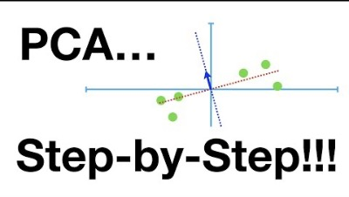
What is a population?
BIO 594

Slide 64
What is a population?
Novembre et al. 2008
BIO 594

Slide 65
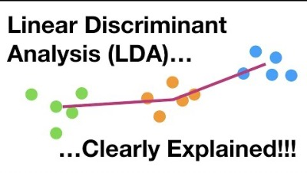
DAPC
DAPC
Uses principal component analysis to decompose the variation in allele frequencies into discrete axes
Groups can be input or inferred
Within group variation is minimized and between group variation maximized.
Can be used with either neutral or adaptive loci
Novembre et al. 2008
BIO 594

Slide 66
DAPC for detecting selection
Schiebelhut et al. 2018

Slide 67
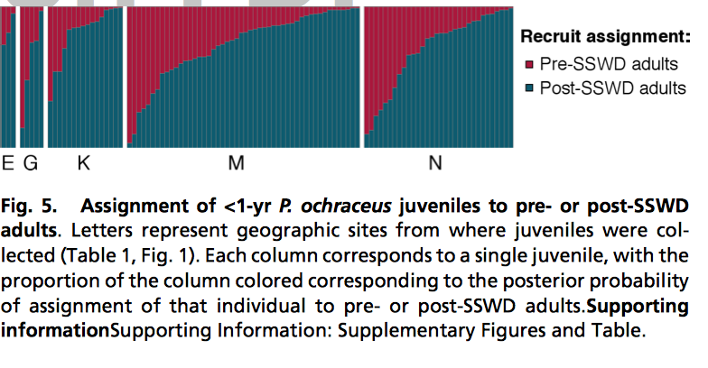
DAPC for detecting selection
Schiebelhut et al. 2018

Slide 68
DAPC for detecting selection
Schiebelhut et al. 2018

Slide 69
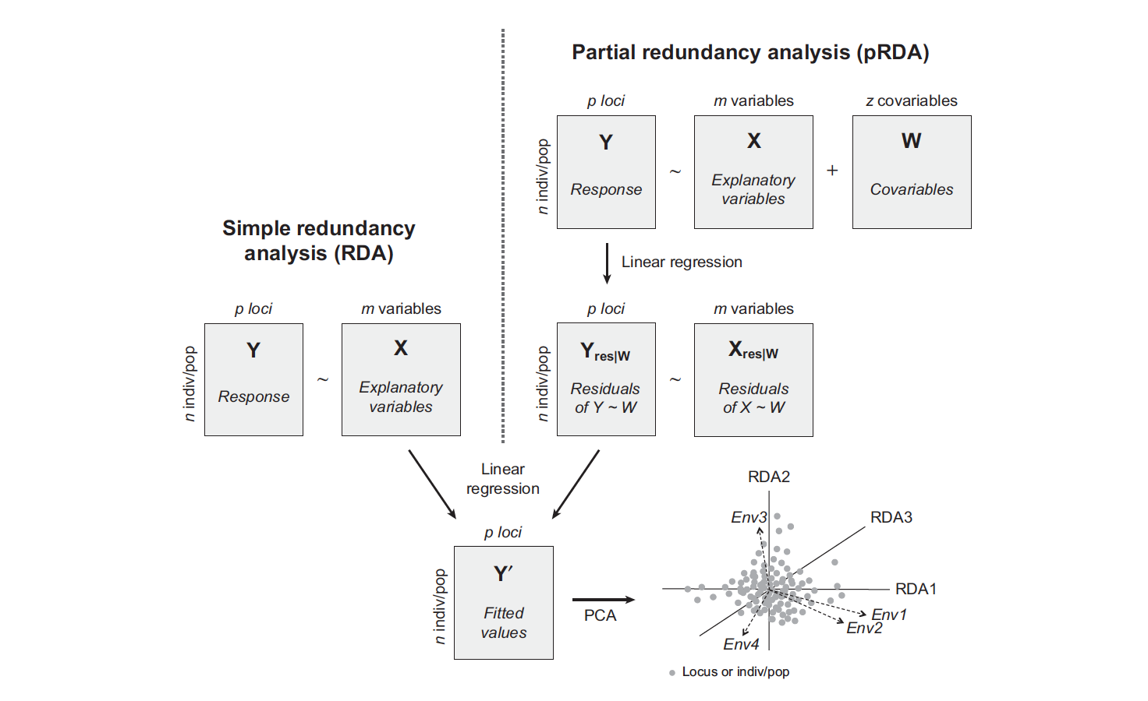
RDA for population Genomics
RDA is a highly flexible framework, which allows us to address four major questions in landscape genomics:
What environmental/spatial processes drive patterns of genetic variation?
What is the genetic basis of local adaptation to the environment?
How is adaptive genetic variation distributed across landscapes?
What are the impacts of climate and/or landscape change on the distribution of adaptive genetic variation?
Capblancq and Forester 2021

Slide 70
RDA for population Genomics
Capblancq and Forester 2021

Slide 71
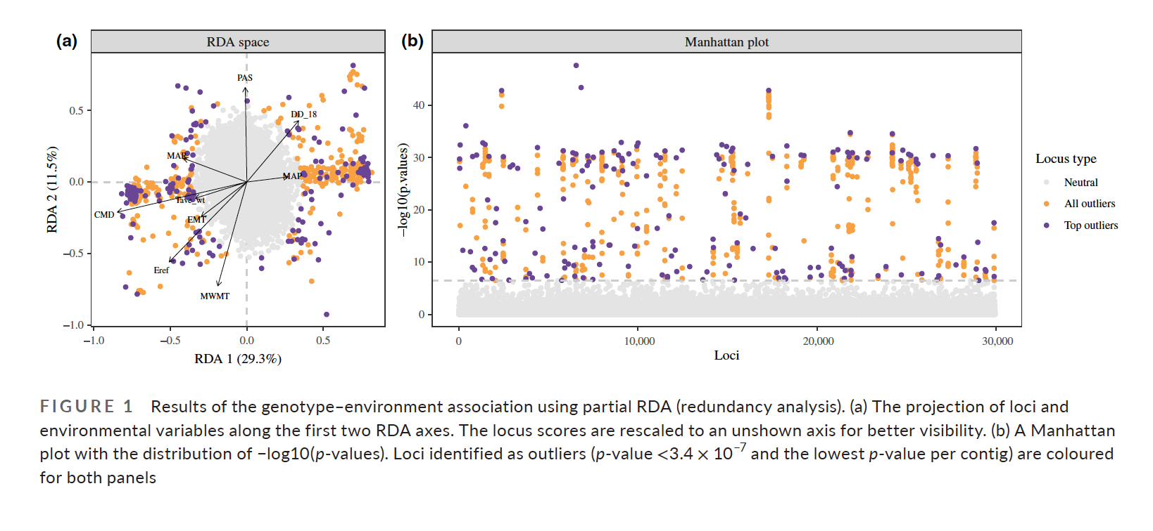
RDA for population Genomics
Capblancq and Forester 2021

Slide 72
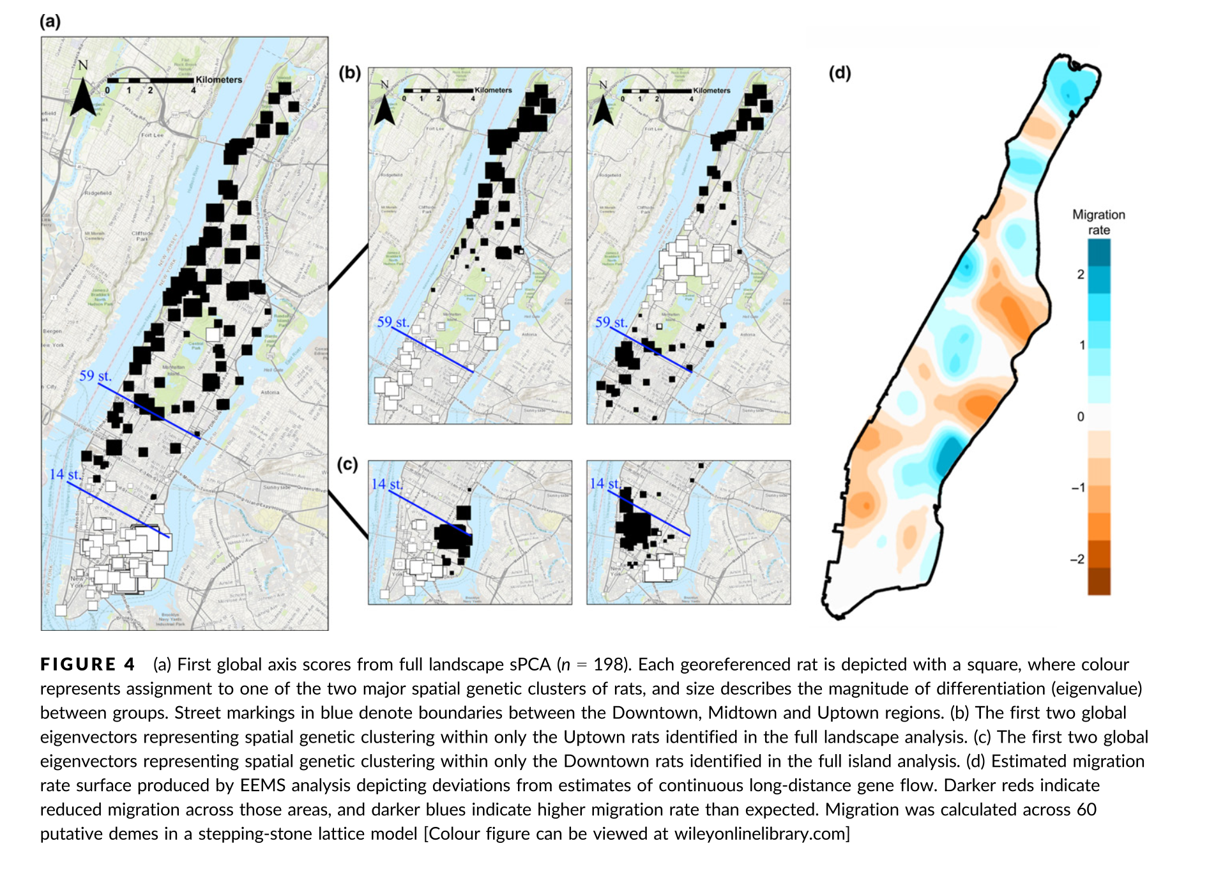
Population connectivity
Combs et al. 2018
BIO 594

Slide 73
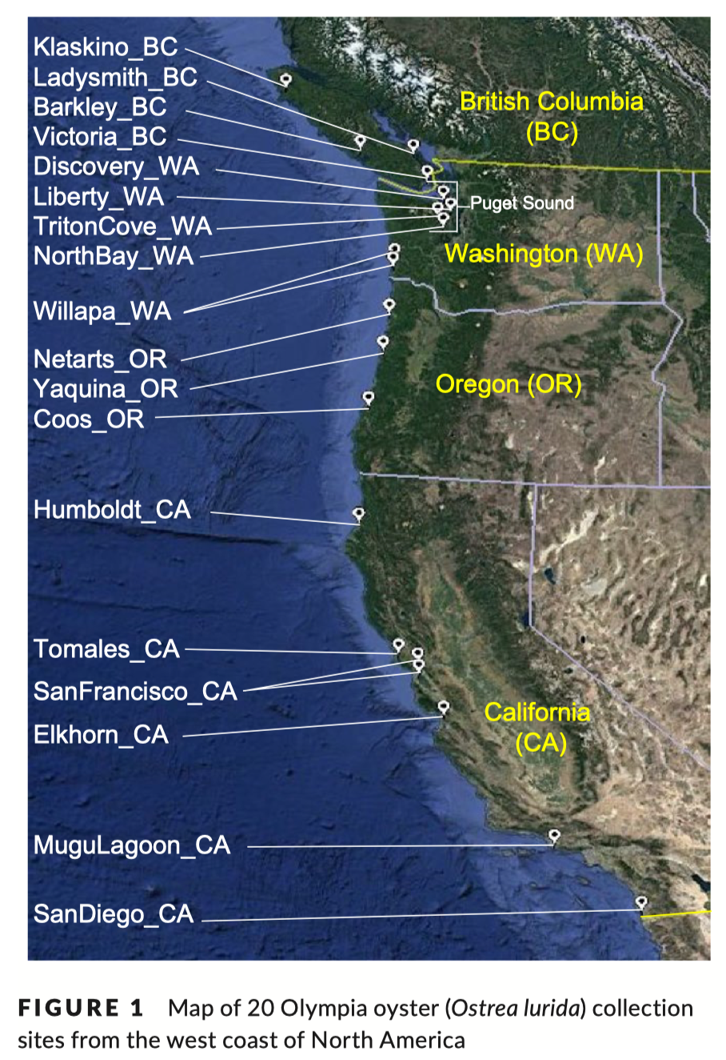
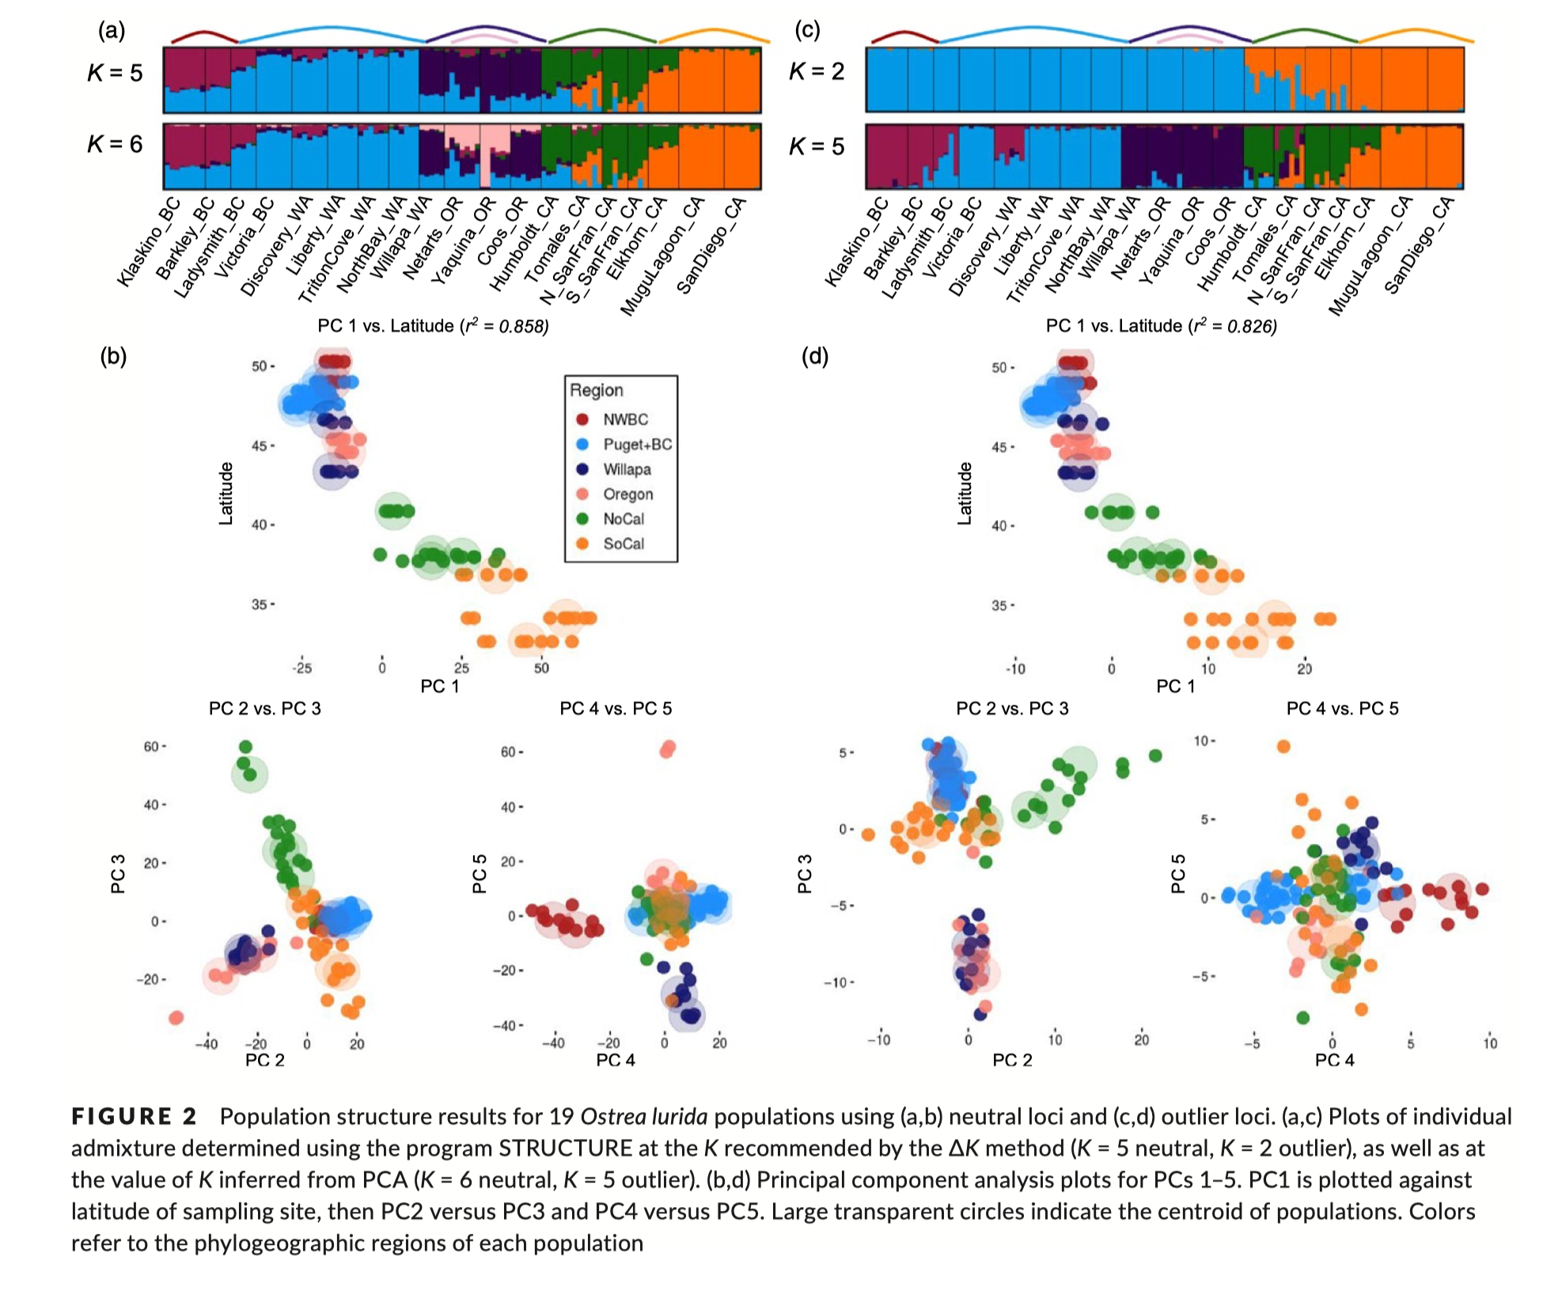
Population connectivity
Silliman et al. 2018
BIO 594

Slide 74
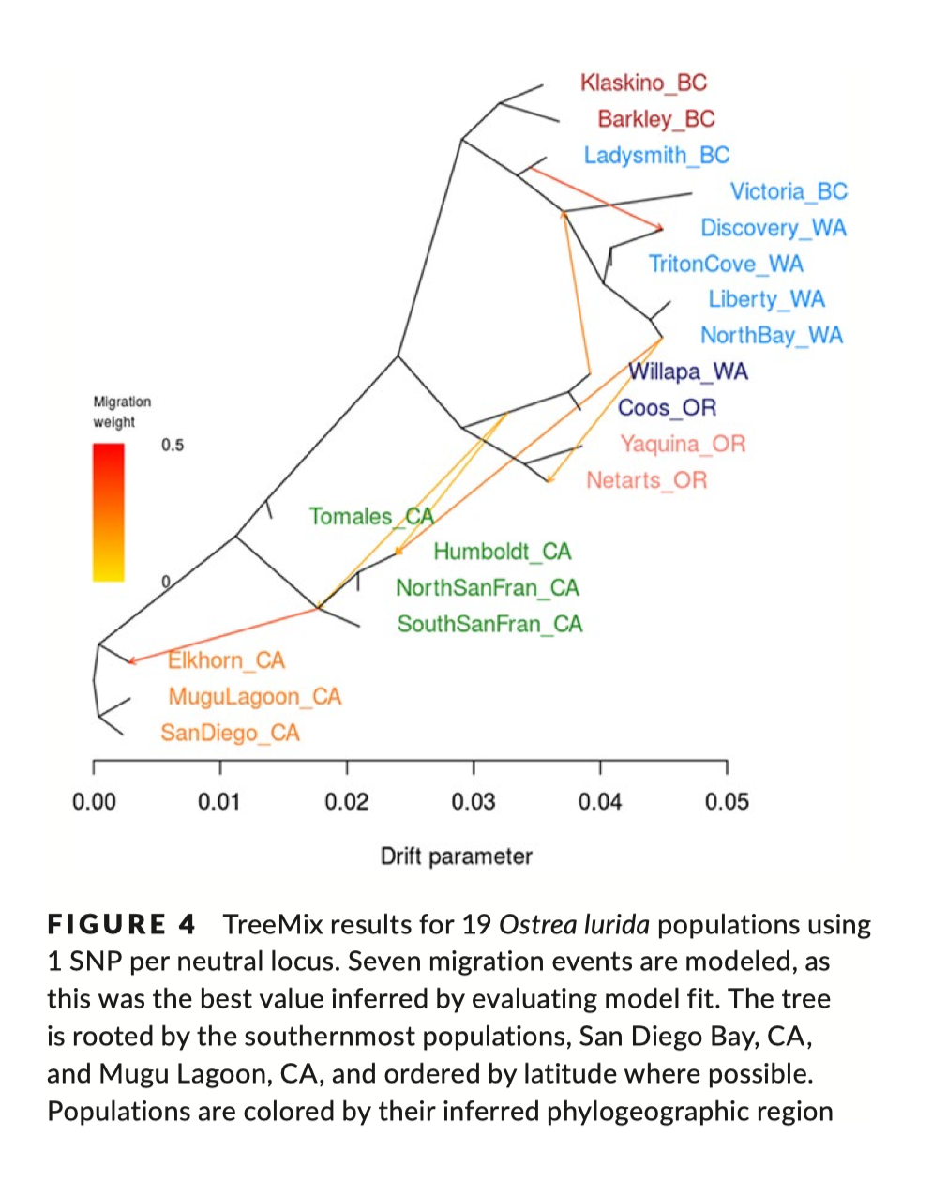
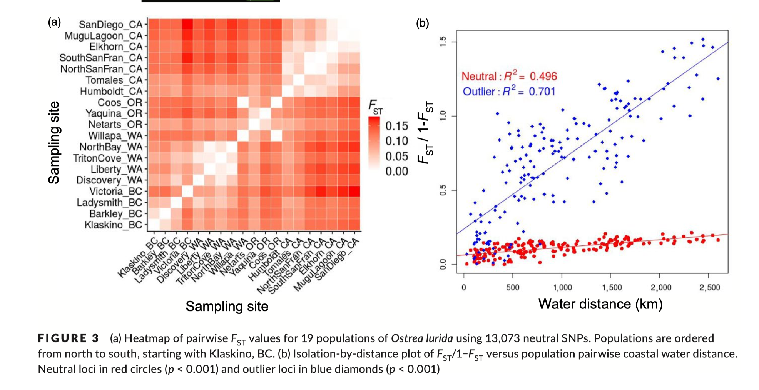
Population connectivity
Silliman et al. 2018
BIO 594

Slide 75
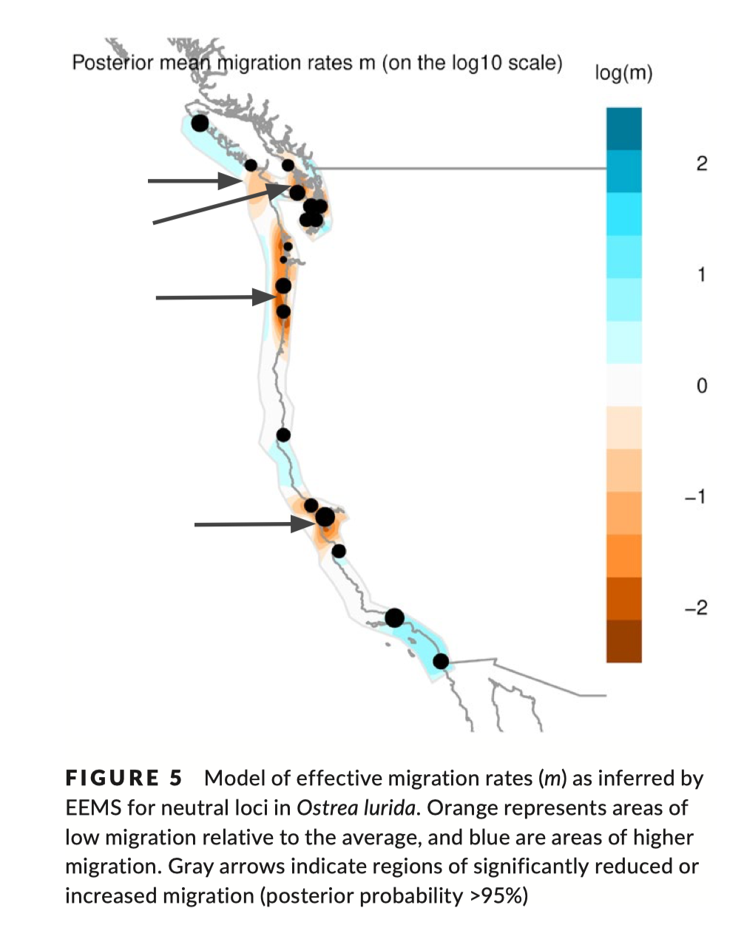
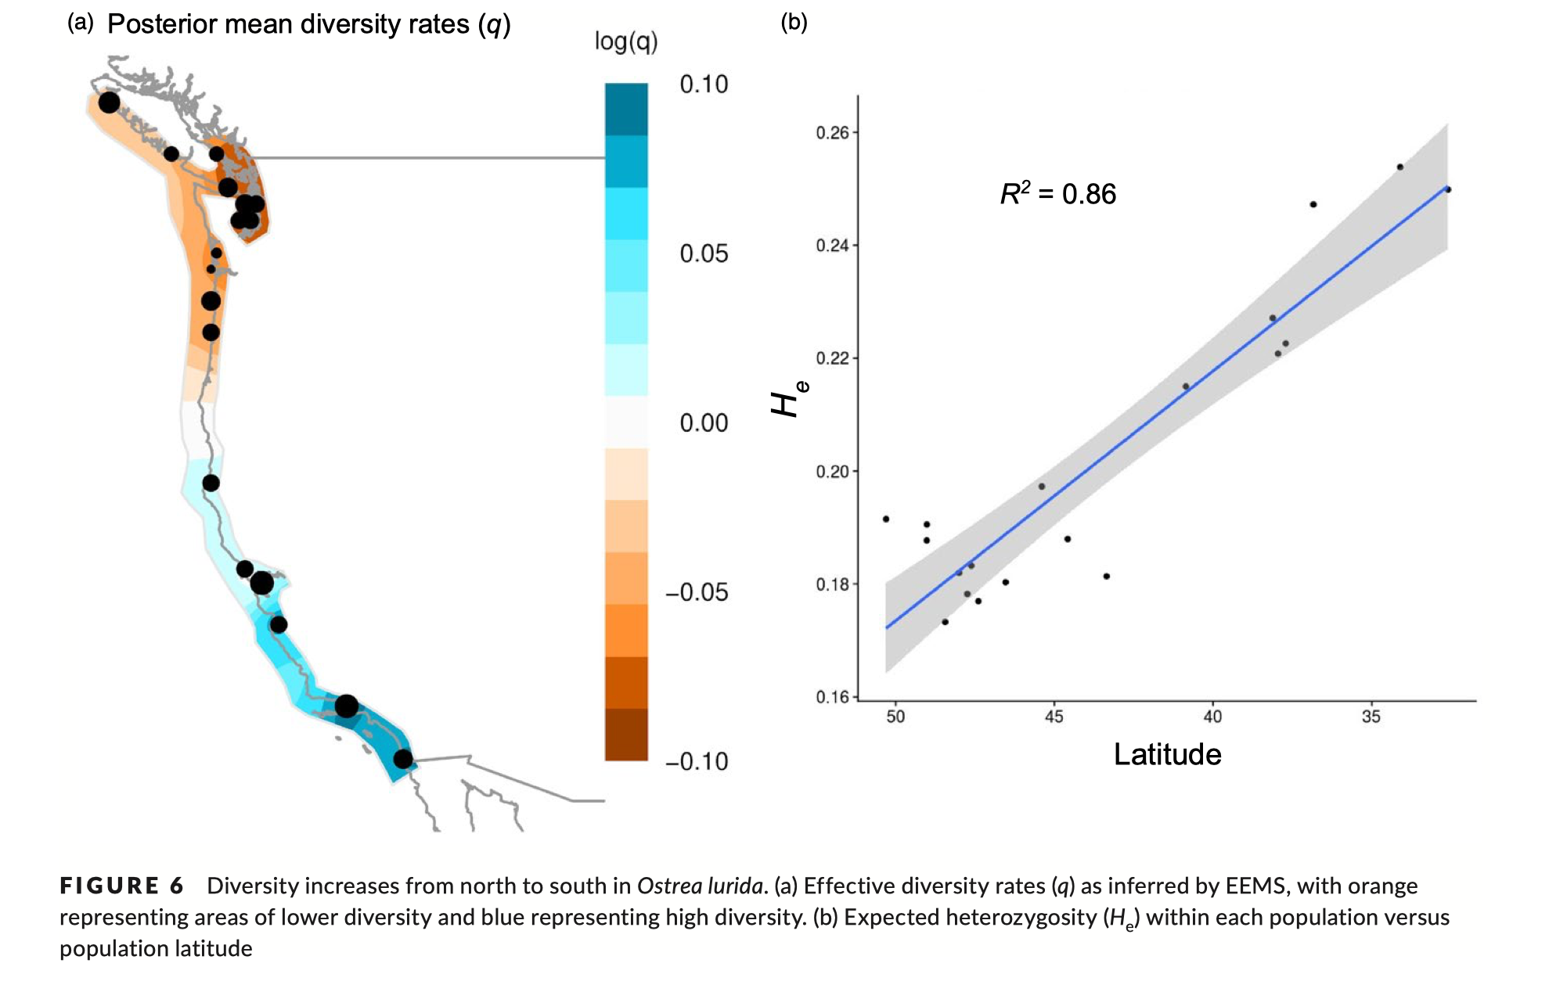
Population connectivity
Silliman et al. 2018
BIO 594

Slide 76
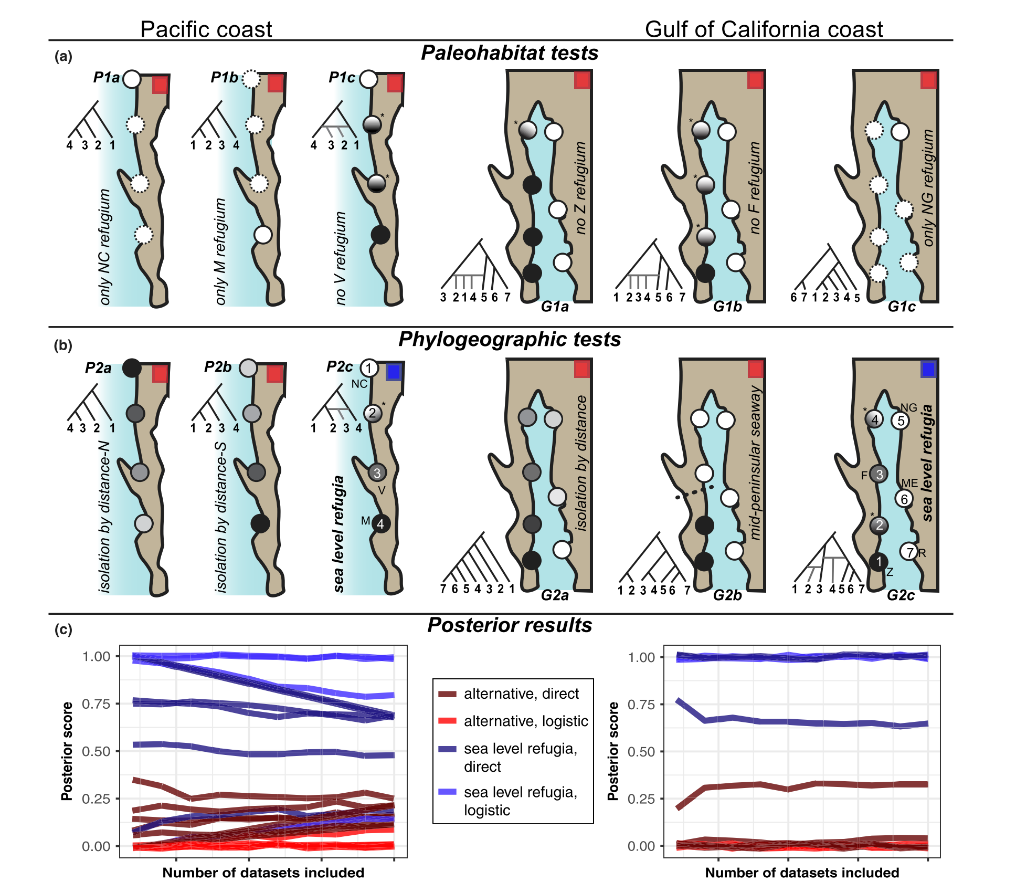
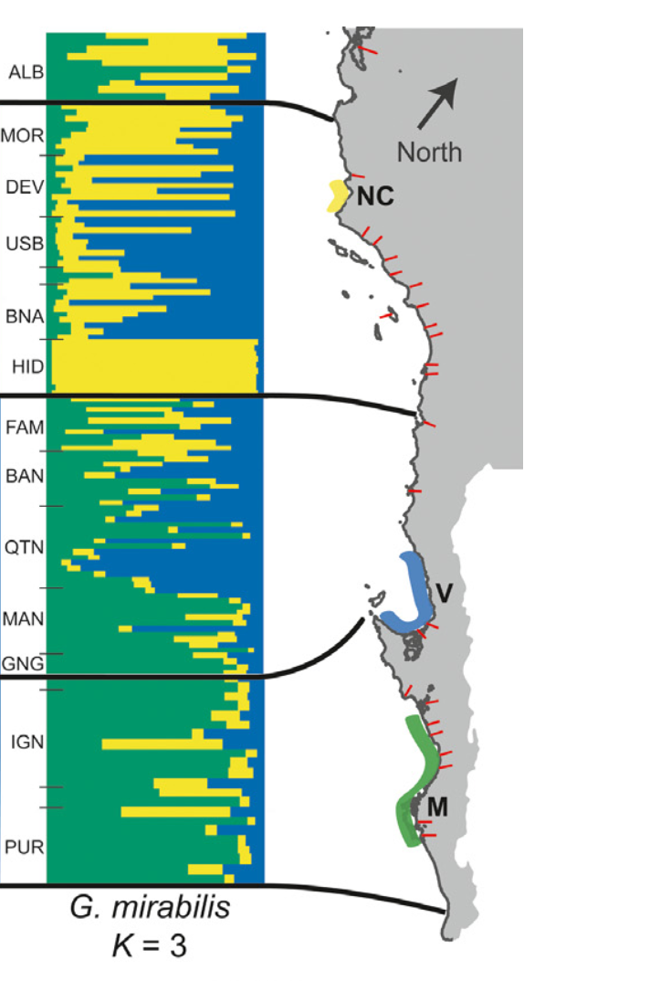
Inferring historical demography
BIO 594

Slide 77
Live Coding
Using the package adegenet
PCA
Missing data
Relatedness
DAPC
Inferring groupings
Inferring loci contribution
Inferring group membership

Slide 78
Exercise
In the directory, `/home/BIO594/Exercises/Week07_and_Week_08/simulated` you will find fastq files, library information, environmental info, and a popmap
For the simulated data
Call SNPs
Filter the SNPs
Perform and document all analyses that were demoed during class
Push to /BIO_594_2022/Exercises/Week07 of the class github repository

